Slide 1
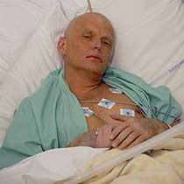
IS RADIATION WORTH
THE RISK??

Slide 2
Is Radiation Worth the Risk? Lesson Outcomes
To be able to explain the dangers and risks posed by radiation.
To be able to explain which source of radiation is most dangerous inside and outside the body.
To be able to collate the benefits and risks of nuclear energy to form a balanced opinion on Nuclear Energy.

Slide 3
Meet the ex Russian Spy Alexander Litvinenko

Slide 4
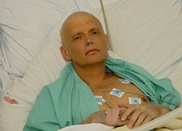
On 1st November 2006 Alexander was admitted to hospital after dining in a sushi restaurant in Central London.
3 weeks later Alexander Litvinenko died. His appearance had changed slightly..

Slide 5
watch movie
What killed Alexander
Litvinenko?

Slide 7
Radiation Poisoning
18
Alexander Litvinenko
Russian spy Alexander Litvinenko poisoned by ingestion of ²¹⁰Po
²¹⁰Po is naturally occurring and around 1million times more poisonous than cyanide
Initial effects may have included
- nausea, vomiting, fatigue, bleeding gums, hair loss
Symptoms of radiation sickness – production of Hydrogen peroxide in body
Then……
- gastro-intestinal failure
- destruction of red bone marrow - immune system fails
- shutdown of central nervous system
- multiple organ failure
- death (within a month of ingestion)
Resulting from alpha particles interacting within the body
- DNA damage
Notes:
Potential antidote -

Slide 8
Have you got the answer to these questions?
What element killed Mr Litvinenko?
What type of radiation is associated with this element?
Is this radiation particularly dangerous?
There are reports of radiation being leaked in planes. What kind of risk did people have of getting radiation poisoning?

Slide 9
So what are the harmful effects of radiation posioning?

Slide 10
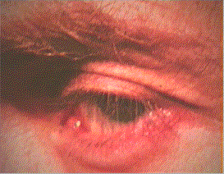
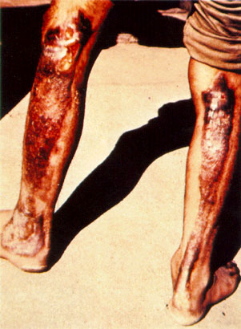
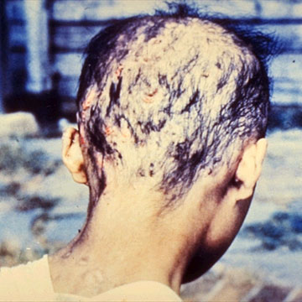
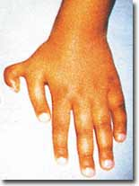
External Effects
Hydrogen peroxide production in the eye
Radiation Burns
Hair Loss
Mutation

Slide 11
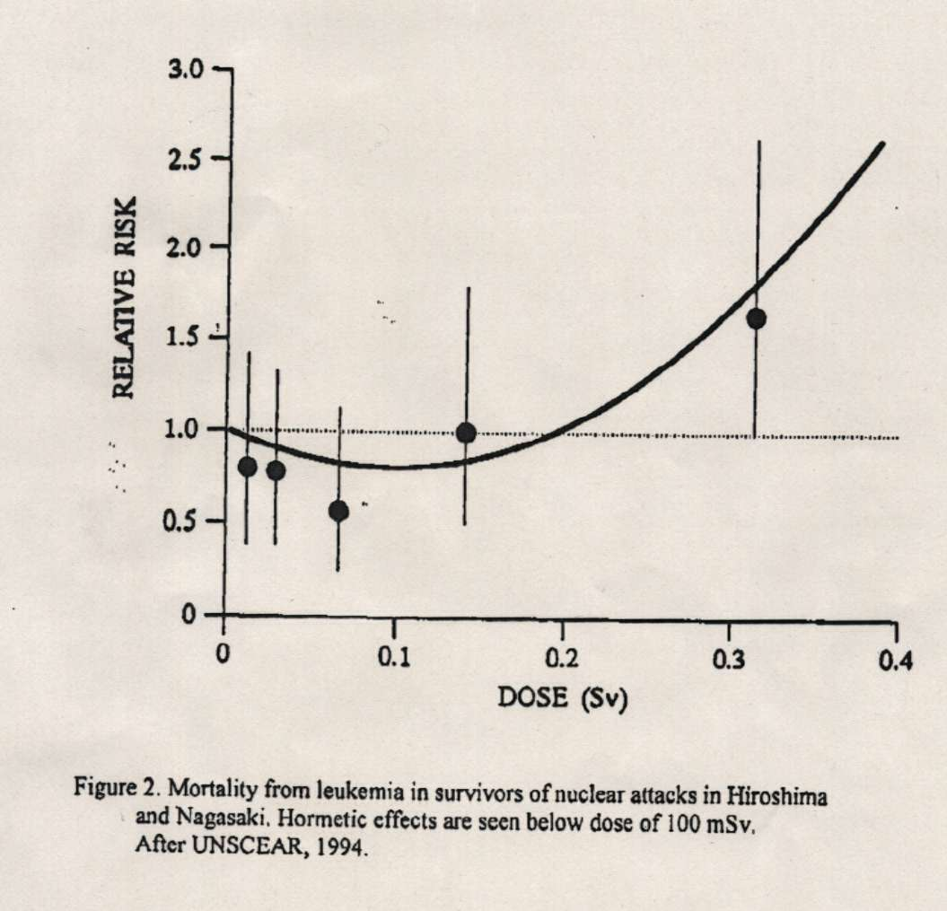
Radiation Hormesis
19
It might not all be bad news……can radiation be good for you?
There are some studies which suggest that a little bit of radiation might actually be good for you!
Animals exposed to inhalation of uranium dust lived longer and had more offspring than non-contaminated animals
Death from Leukaemia in Hiroshima survivors
Ionising Radiation
Small doses of radiation seem to reduce the risk of death!!
Seems strange but it MIGHT be true

Slide 12
Is Radiation Worth the Risk? Lesson Outcomes
To be able to explain the dangers and risks posed by radiation.
To be able to explain which source of radiation is most dangerous inside and outside the body.
To be able to collate the benefits and risks of nuclear energy to form a balanced opinion on Nuclear Energy.

Slide 13
Radiation outside the body
Radiation outside the body
When sources of radiation are outside
the body;
Beta and gamma radiation are the most dangerous because they may reach the cells of organs and may be absorbed by them
Alpha radiation is the least dangerous because it is unlikely to reach living cells

Slide 14
Radiation outside the body
Radiation outside the body

Slide 15
Radiation outside the body
Radiation outside the body

Slide 16
Radiation inside the body
Radiation inside the body
When sources of radiation are inside the
body;
Alpha radiation is the most dangerous because it is the most ionising
Beta and gamma are less dangerous because the cells are less likely to absorb the radiation

Slide 17
Radiation inside the body
Radiation inside the body

Slide 18
Radiation inside the body
Radiation inside the body

Slide 19
Is Radiation Worth the Risk? Lesson Outcomes
To be able to explain the dangers and risks posed by radiation.
To be able to explain which source of radiation is most dangerous inside and outside the body.
To be able to collate the benefits and risks of nuclear energy to form a balanced opinion on Nuclear Energy.

Slide 20
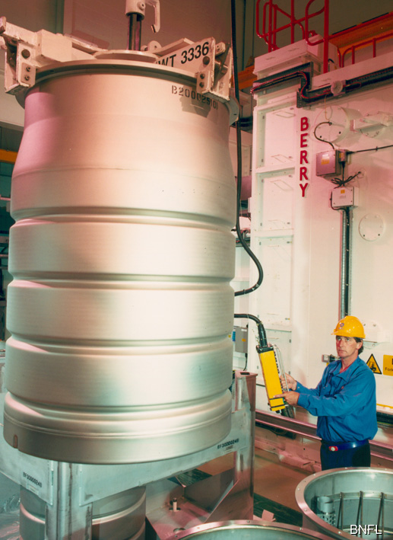
How is nuclear waste dealt with?
Spent fuel rods are sent to a reprocessing plant to recover any usable uranium and plutonium.
Many of the isotopes in the remaining waste have no practical purpose and are too dangerous to be released to the environment.
Strict regulations are followed when handling and storing nuclear waste.
Some waste can be stored in cement inside reinforced steel drums.
Long-term storage of nuclear waste is a major problem. Why is it so difficult to find suitable sites?
Notes:
Photo credit: BNFL
Checking a drum filled with intermediate level nuclear waste at a Waste Encapsulation Plant - (WEP).
Intermediate-level waste is made up of such things as fuel element cladding, contaminated equipment and sludge that come from the treatment processes. The waste is put into cement inside steel drums. This is then put into a concrete store, above ground, before it is eventually disposed of in a repository. The waste is in a solid form, which means that it is very difficult for radioactivity to escape into the environment.
More information about nuclear fuel and waste is available at www.bnfl.com.

Slide 21
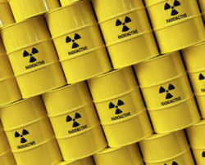
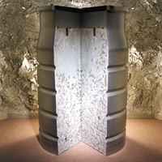
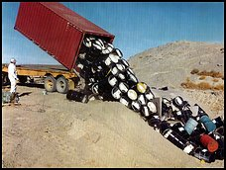
Next page
Disposing of Radioactive Waste
Getting rid of waste from using radioactive materials is a problem
High Level Waste (HLW)
Very radioactive waste that has to be stored carefully. Only small amounts are made and it doesn’t last long. Put into short term storage
Intermediate Level Waste (ILW)
Remains radioactive for thousands of years. The amount produced is increasing and becoming a problem. Intermediate waste is mixed with concrete and stored in large containers
Low Level Waste (LLW)
Only slightly radioactive. It is sealed and placed in landfills
Back to P2d
Main menu

Slide 22
Is Radiation Worth the Risk? Lesson Outcomes
To be able to explain the dangers and risks posed by radiation.
To be able to explain which source of radiation is most dangerous inside and outside the body.
To be able to collate the benefits and risks of nuclear energy to form a balanced opinion on Nuclear Energy.

Slide 23
The government proposes to build a nuclear power station in Southall. Write a letter to the Prime Minister outlying the following issues
The problems relating to radioactive radiations on human life
If appropriate steps have been put in place to get rid of the radio active waste.
Your letter must contain proper address, date , introduction, arguments, summary and appropriate greetings.

