Slide 1
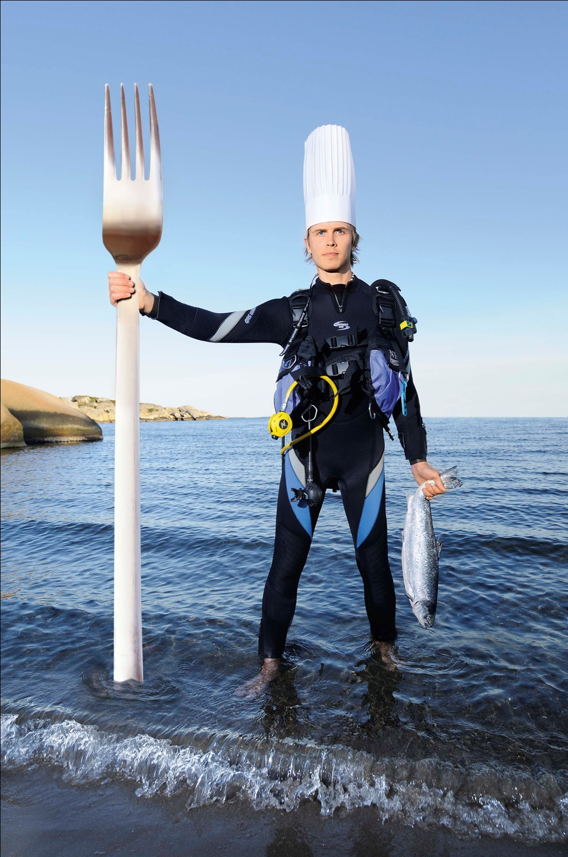
Cooking With Waves

Slide 2
Cooking with waves
Lesson Outcomes
Key Words:- Microwaves, Infra Red, Diffraction, absorb, vibrate, transfer, shiny, dull
To be able to explain how Infra Red and Microwaves can be used for cooking.
To be able to explain what is meant by diffraction
To be able to explain why mobile phones use microwaves instead of radio waves to communicate with satellites.

Slide 3
Starter
What are the tree types of heat transfer?
How does heat transfer in Space?
Why are the inside of Thermos flask coated shiny silver?

Slide 4
Let’s recap what we know about infra red radiation

Slide 5
Emitting Radiation
Emitting Radiation

Slide 6
Dark Matt Coloured Objects are best at emitting Infra Red Radiation.
White or shiny objects are worst emitters of Infra Red Radiation.
This is because they reflect the radiation instead.

Slide 7




Investigating thermal absorption
Notes:
Teacher notes
This virtual experiment investigates the ability of different surfaces to absorb heat. It could be use as a precursor to running the practical in the lab or as a revision exercise. To extend the activity, students could be asked to consider which variables need to be controlled to make this experiment fair and accurate.

Slide 8
Conclusion
What do your results show you?
Form a conclusion.

Slide 9
Absorption of Radiation
Absorption of Radiation

Slide 10
Conclusion
Dark, Matt Colours are the ______ absorbers of Infra Red Radiation.
Light Shiny objects (Aluminium Foil) are the _______ absorbers of Infra Red Radiation. This is because they ______ them.

Slide 11
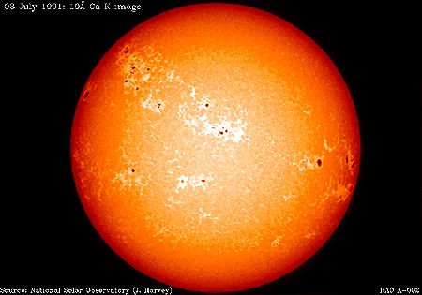
Radiation
Radiation is when heat moves around in electromagnetic _________ like light does. Any hot object will emit heat radiation – the hotter it is, the more radiation it emits. This type of radiation is called __________, and too much of it will cause _________. Dark, matt colours will absorb AND emit the _____ infra-red radiation, and light, shiny colours will ________ it.
The main difference with radiation is that conduction and convection could ONLY happen in solids, liquids or gases, whereas radiation will happen through an _____ _____. This is just as well, as otherwise we wouldn’t be able to get any heat from the ___.
Words – sun, reflect, infra-red, waves, most, empty space, sunburn
Anything HOT emits HEAT RADIATION – the hotter it is, the more infra red radiation it emits

Slide 12
IR DEMOS
IR Webcam and Normal Webcam. Plug both webcams in a lab with black out (totally dark) and try out different things:-
  Shine IR signal from a remote control towards different objects
  Look at a simple light bulb connected across a variable resistor (or resistance substitution box). Slowly increase the resistance. There will be a point where the visible camera will show the light bulb has gone off but the IR camera will still show it on. This is great because you are seeing something invisible!!
IR sensor and remote control can show digital signals (screen cap on next slide)
IR Thermometers. Point at some hot objects (NOT yourself!!).

Slide 13
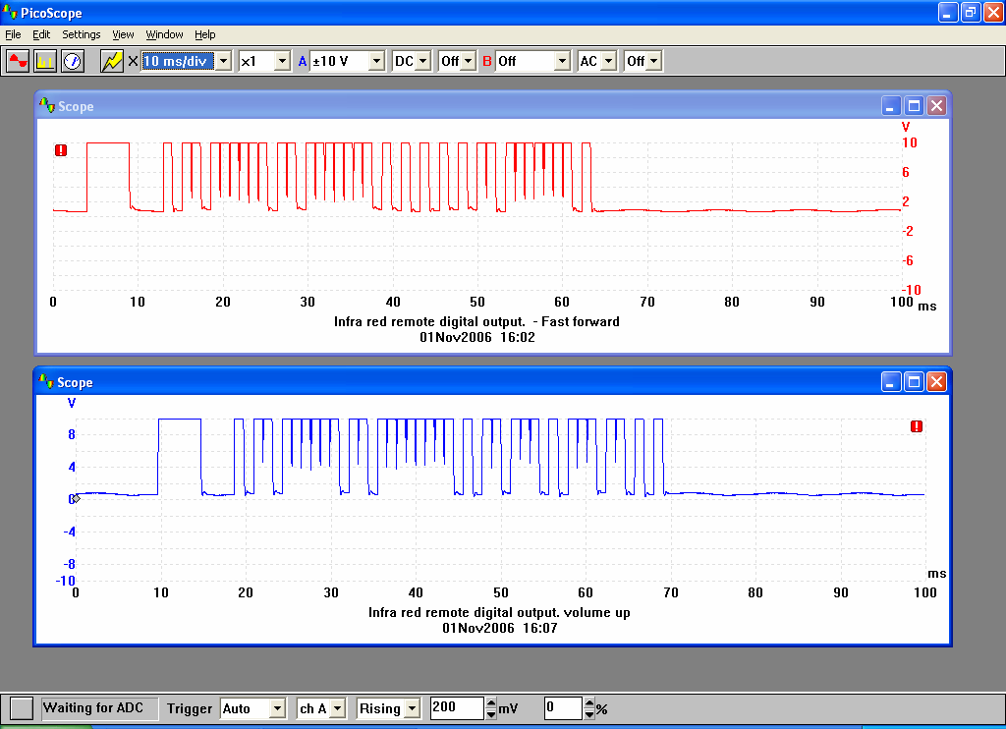

Slide 15
Cooking with waves
Two of the waves from the Electromagnetic Spectrum can be used to cook food.
What are these waves and what devices use them for cooking?
  Microwave wave – Microwave Oven
  Infra Red wave – Oven
How do these waves work?

Slide 16
How do Gas Fire Ovens Work?
Discuss with the person next to you.
Think about:-
  How does the heat transfer from the fire to the food?
  How is the heat transferred inside the food?

Slide 17
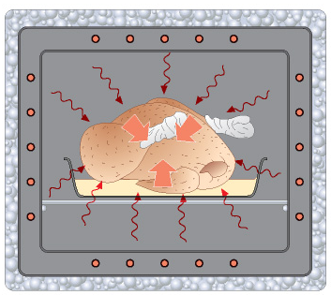

Slide 18
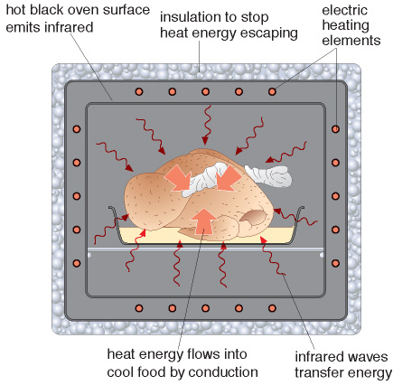

Slide 19
How do Microwaves Work?
How are microwave ovens different to Gas Fired Ovens.
List some differences. Discuss with the person next to you…
Why does the microwave oven need these features?

Slide 20
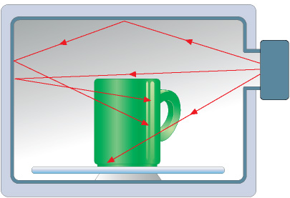

Slide 21
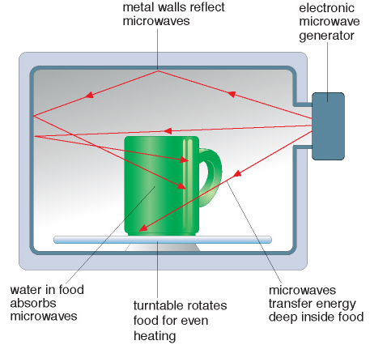

Slide 22
A very detailed explanation of how Microwaves work.

Slide 23
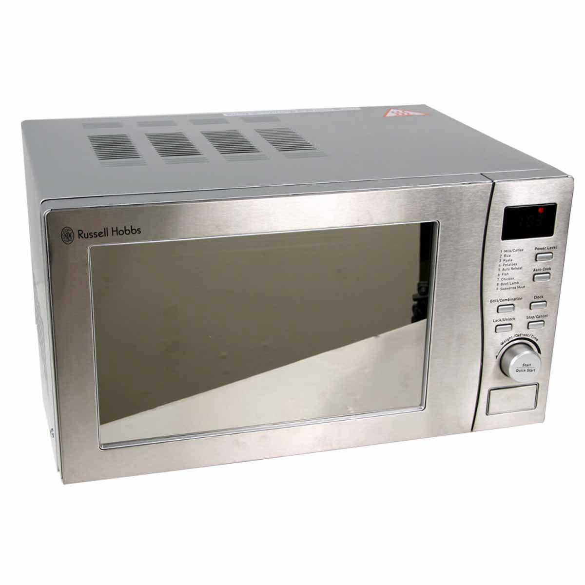
How does a microwave work?
(some) Microwaves are the same frequency as the resonant frequency of the bonds in a water molecule
They are then absorbed and cause the molecule to vibrate

Slide 24
Microwave Demo
Microwave rivata slices (or dried stale bread) for 20 seconds on full power. Then microwave some chocolate or marshmallows for the same amount of time.
Students try and explain their observations.

Slide 25
How is microwave cooking different to oven cooking?
Discuss with the person next to you.

Slide 26
How is microwave cooking different to oven cooking?
Watch this advert.
What are the differences between microwave cooking and oven cooking?
Why is oven cooking better for a jacket potato?

Slide 27
Some typical exam questions
Explain how microwaves and infrared transfer energy to materials
  microwaves absorbed by water particles in outside layers increasing their KE
  infrared is absorbed by all particles on the surface increasing their KE
  energy transferred to centre of food by conduction or convection

Slide 28
Some typical exam questions
Describe how the energy associated with microwaves and infrared depend on their frequency and relate this to their potential danger
  High frequency means High energy
  Can be absorbed and cause

Slide 29
Cooking with waves
Lesson Outcomes
Key Words:- Microwaves, Infra Red, Diffraction, absorb, vibrate, transfer, shiny, dull
To be able to explain how Infra Red and Microwaves can be used for cooking.
To be able to explain what is meant by diffraction
To be able to explain why mobile phones use microwaves instead of radio waves to communicate with satellites.

Slide 30
What are some common properties of light?
Light travels at the fastest speed possible in the Universe (3x10⁸ m/s)
Light does NOT need any substance to travel (it can travel in space)
White Light is made up of 7 different colours (ROYGBIV)
A lot of invisible light is also emitted by the sun. This is called the EM Spectrum
Light travels in straight lines
Light can be reflected from shiny surfaces

Slide 32
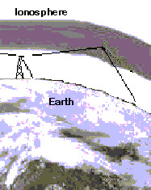
Communication
Television, radio and mobile telephone signals are sent using radio waves or microwaves.
Long wave radio waves can travel long distances because they are reflected by the Earths atmosphere.
Hence, they can be sent over long distances as they follow the Earths curvature.

Slide 33
Satellites
Microwaves travel straight through the Earths atmosphere and are not reflected.
This makes the useful for communicating with satellites.

Slide 34
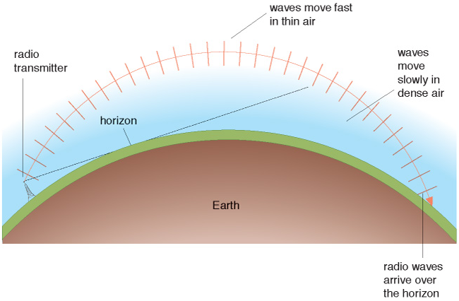
Refraction of waves
Refraction is caused by the top of the radio wave travelling faster than the bottom

Slide 35
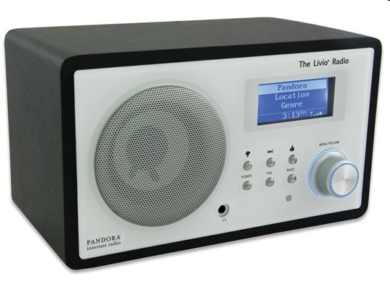
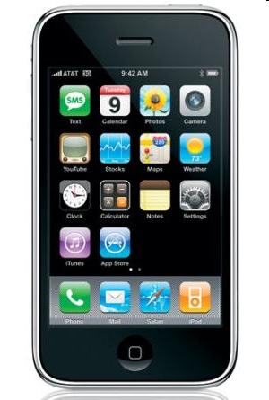
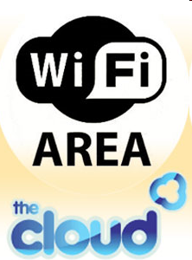
Uses
Radio
  Signal
    Radio waves
Mobile Phones
  Reception
    Microwaves
  Data transfer
    Microwaves or Infra Red
Laptop computers
  Wifi
    Microwaves

Slide 36
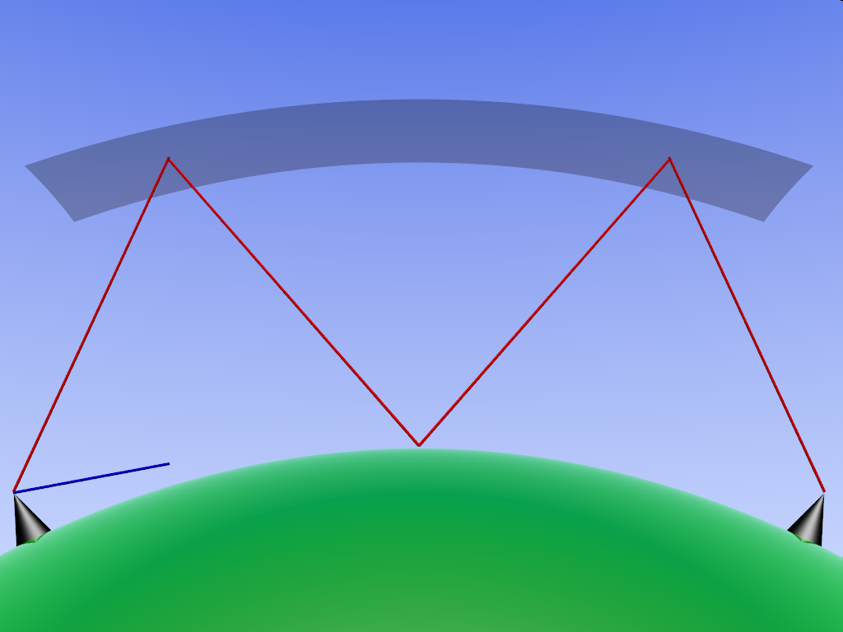
Long distance communication*
Requires either reflection or relay of signal
  Reflection from the Ionosphere
  Satellites can receive signals and re-transmit them
Ionosphere
Signal is reflected by the Ionosphere to allow long distance communication
Line of sight would miss target

Slide 37
Diffraction Demo
Use Ripple tank to demonstrate Diffraction of water waves. Students might feel that only water waves diffract.
Demonstrate the microwave transmitter and receiver to show that light also diffracts.

Slide 38
Diffraction in a ripple tank

Slide 39
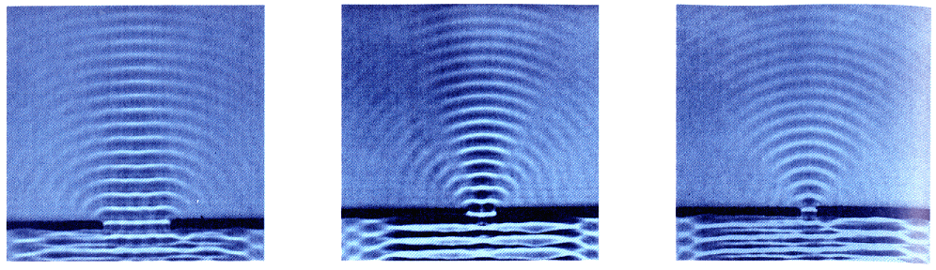
Diffraction through a gap

Slide 40
Diffraction through a smaller gap

Slide 41
Diffraction through a small gap

Slide 42
Diffraction through various gaps

Slide 43
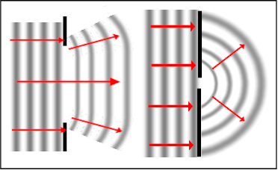
Summary
The extent of the spreading depends on how the width of the gap compares to the wavelength of the waves.
The bigger the width of the gap compared with the wavelength of the wave, the less the diffraction.

Slide 44
Cooking with waves
Lesson Outcomes
Key Words:- Microwaves, Infra Red, Diffraction, absorb, vibrate, transfer, shiny, dull
To be able to explain how Infra Red and Microwaves can be used for cooking.
To be able to explain what is meant by diffraction
To be able to explain why mobile phones use microwaves instead of radio waves to communicate with satellites.

Slide 45
Blocking reception
Microwaves can be blocked by obstructions

Slide 46
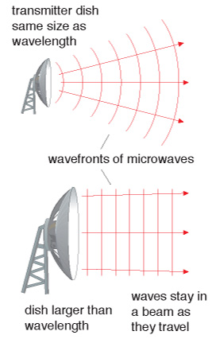
Diffraction*
Diffraction (spreading out) of wireless signals occurs when the dish is smaller than the waves it is sending out
This Causes signal loss over large distances

Slide 47
Using Satellites with microwaves
Microwaves are used to communicate with satellites
This is because they can easily pass through the ionosphere.

Slide 48
Using Radio waves
Radio waves are reflected off the ionosphere (an electrically charged layer in the atmosphere). This allows us to send radio signals around the curvature of the Earth.

Slide 49
Diffracting Radio Waves
A low frequency radio wave can be diffracted over obstacles but some signal strength will be lost.

Slide 50
Can you answer the following questions?
Why are microwaves used to communicate with Satellites instead of radio waves?
Why don’t we send microwaves directly around the earth?
Why are AM radio stations (Sunrise Radi, BBC Five Live etc) more likely to be picked up over the whole UK whereas FM radio stations are confined to 1 city (Kiss 100, Capital etc)?

Slide 51
Cooking with waves
Lesson Outcomes
Key Words:- Microwaves, Infra Red, Diffraction, absorb, vibrate, transfer, shiny, dull
To be able to explain how Infra Red and Microwaves can be used for cooking.
To be able to explain what is meant by diffraction
To be able to explain why mobile phones use microwaves instead of radio waves to communicate with satellites.

