Slide 1
Equipment List
Demos:-
Laser raybox + All Accessories
Laser + Mirror + Smoke Machine
Rectangular see through trough and ruler
Disappearing Test Tube demo (glycerine in test tube in beaker full of glycerine)
Total internal reflection in water demo (water bottle with hole at the bottom and laser)
Laser and Optical Fibre
Optical Fibre Lamp
Class Prac
Raybox, power packs, rectangular glass block and Semi circular glass block

Slide 2
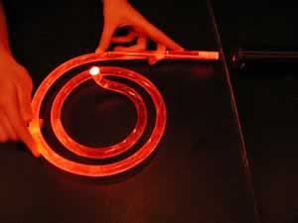
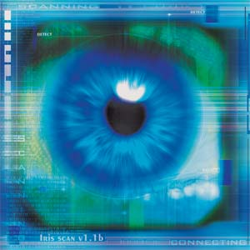
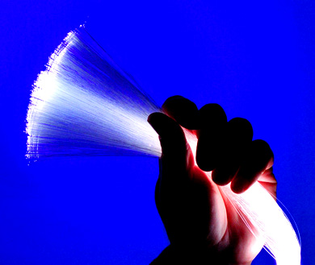
Reflection
and
Refraction

Slide 3
Example of a question from the sample paper for P1
6 Marks including QWC
(10 Minutes)

Slide 4
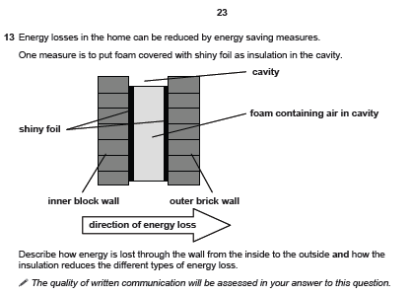

Slide 5
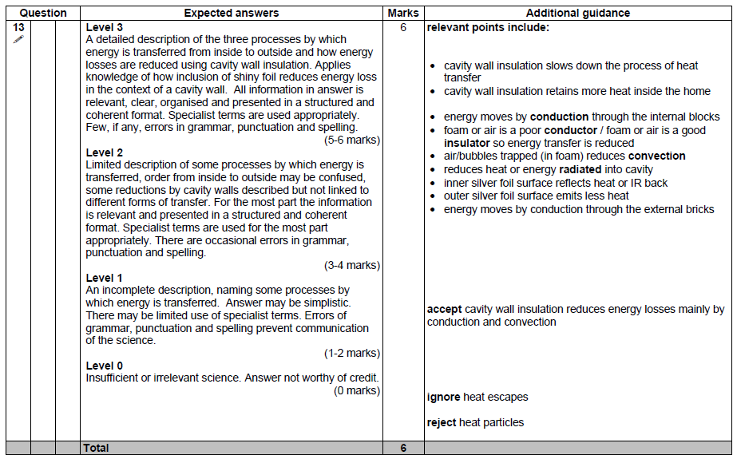

Slide 6
Reflection and Refraction
Lesson Outcomes
Key Words:- Reflection, Refraction, Density, Normal, Incident Ray, Reflected Ray, Refracted Ray, Angle of Incidence, Angle of Refraction, Total Internal Reflection, Perpindicular, Cladding, Optical Fibres.
To be able to explain how waves get reflected and list a use of this in medicine.
To be able explain how light can be refracted and explain how light bends when it enters light.
To be able to explain how light can be Totally internally reflected and list its uses.

Slide 7
Look at the video and discuss how it is possible
Some things to remember:-
  This is not a Camera!
  This is not a dead person.
  This can also be used to perform live surgery.
  How does it work?

Slide 8

Connector
Notes:
Teacher notes
This multiple-choice quiz could be used as a plenary activity to assess students’ understanding of wave properties. The questions can be skipped through without answering by clicking “next”. Students could be asked to complete the questions in their books and the activity could be concluded by the completion on the IWB.

Slide 9
Reflection Demo
Use the laser and shine onto a mirror. Use smoke machine to make the laser visible to students. All students should be able to see that angle of incidence = angle of reflection.
Alternatively use the laser ray box to demonstrate the same.

Slide 10
Reflection
We describe the path of light as straight-line rays
  The line of light hitting the mirror is called ‘incident ray’
  The line of light reflected off the mirror is called reflected ray
Reflection off a flat surface follows a simple rule:
  angle in (incidence) equals angle out (reflection)
  Angle of incidence = angle of reflection
surface normal
same
angle
reflected ray
incident ray

Slide 11
Uses of reflection
Reflection is used for Ultrasound scanning. Have a look at this video and explain how these images were taken:-

Slide 12
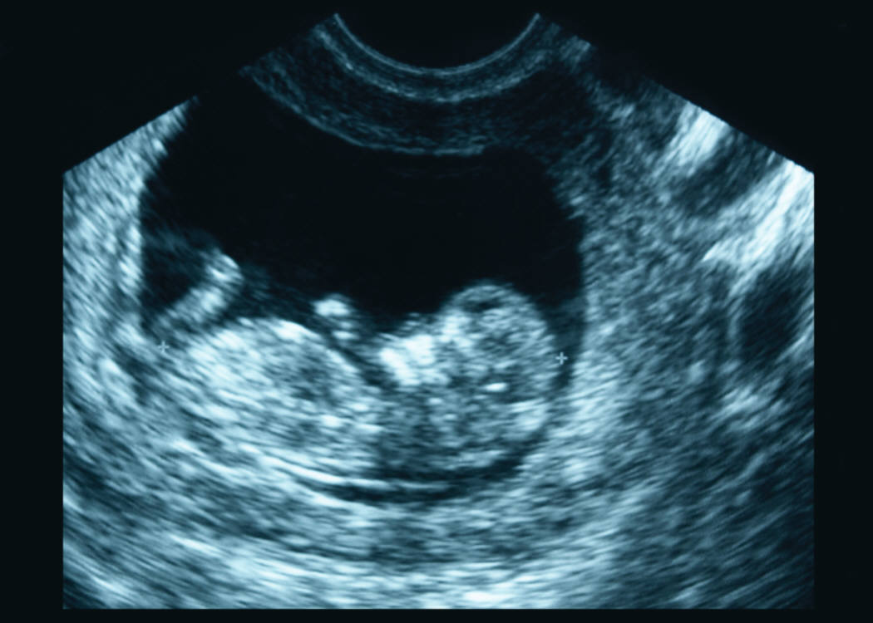
Ultrasound
Have a look at this Ultrasound image.
Why can you see the baby’s head clearly?

Slide 13


What is ultrasound?
The upper frequency limit of human hearing 20 000 Hz.
Any high frequency sound above 20 kHz is called…
ultrasound
Whales and dolphins communicate using ultrasound.
Why does a dog whistle vibrate at ultrasound frequencies?
Can you name another human use of ultrasound?

Slide 14
Using ultrasound
Which of the following does not use ultrasound?
imaging fetuses
dolphins
jewellery cleaning
ultrasonic toothbrush
viewing kidney stones
bats
ultrasonic cleaning
echo location
submarines
It’s a trick question! All of the above involve ultrasound.
High frequencies can be very useful!
Notes:
Use the internet or research books to find out about other uses of ultrasound.
These keywords should help.

Slide 15
Using ultrasound in medicine
Ultrasound is the name given to a medical technique.
It uses high frequency sound waves to produce images of inside the body without opening up the body.
fetus at 10 weeks
fetus at 20 weeks
Why is ultrasound for scanning fetuses instead of X rays which would give a clearer picture?
X rays are more energetic and penetrating and are a lot more dangerous, they could cause damage to the growing baby.

Slide 16
How does Ultrasound scanning work? (make detailed notes)

Slide 17
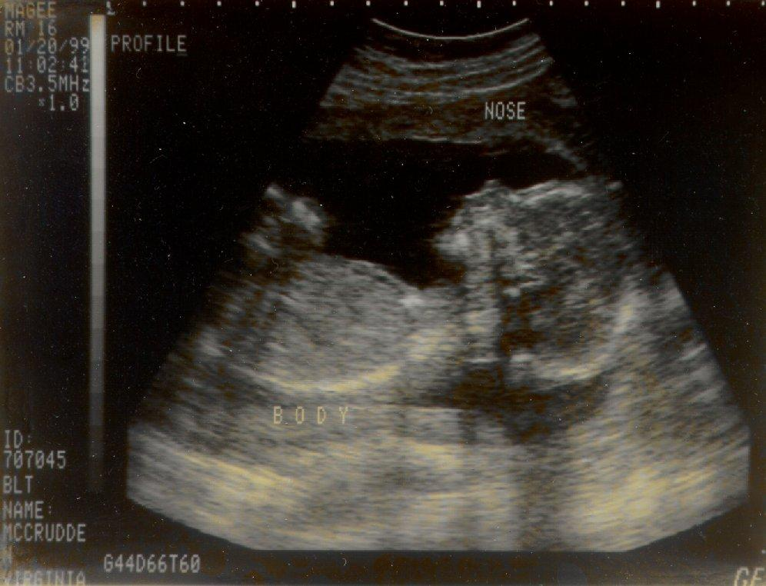
How does ultrasound imaging work?
Ultrasound, like all sound, is reflected when it meets different boundaries. So how is this used for imaging?
An ultrasound machine transmits high-frequency sound waves into the body.
These sound waves are reflected different amounts by different tissues.
The reflected waves are
detected by a receiver.
A computer turns the distance
and intensities of these echoes
into a two-dimensional image.

Slide 18
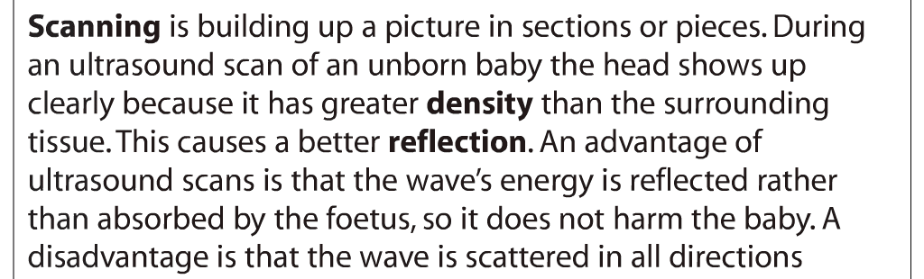

Slide 19
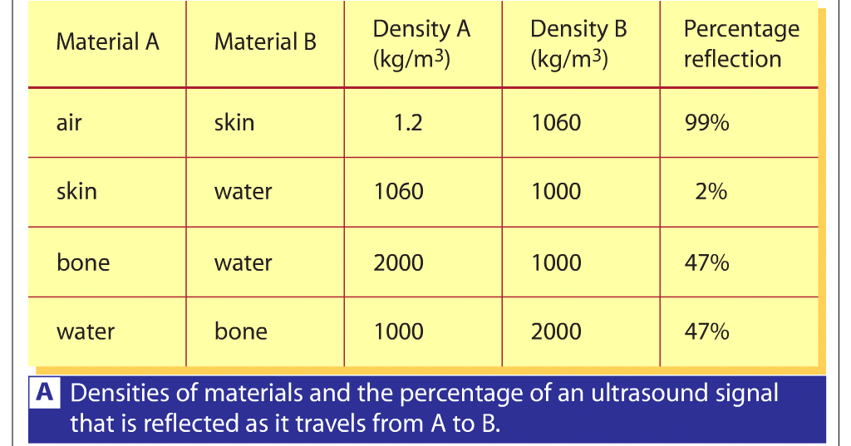
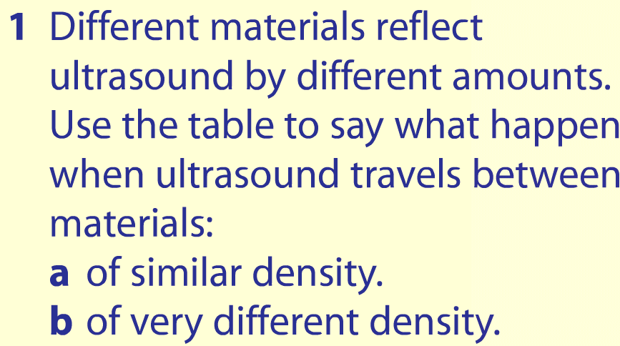

Slide 20
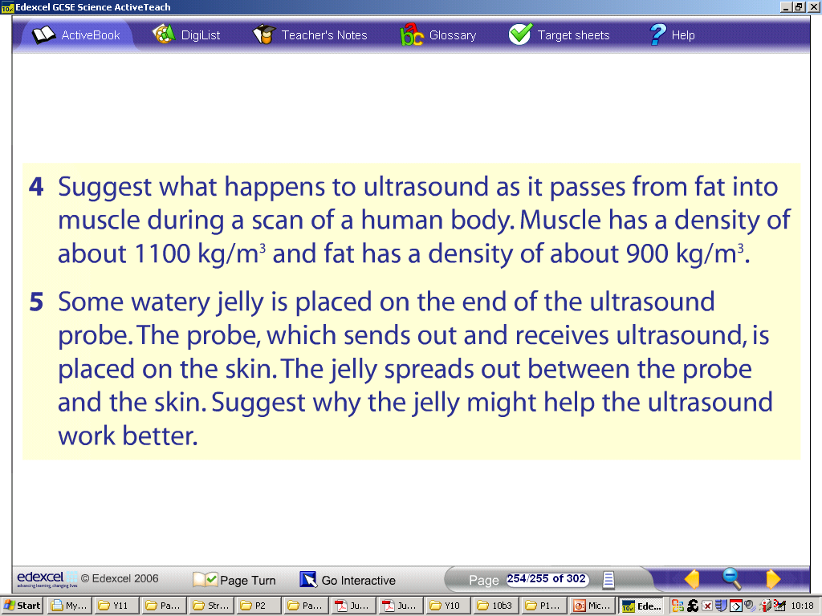

Slide 21
Reflection and Refraction
Lesson Outcomes
Key Words:- Reflection, Refraction, Density, Normal, Incident Ray, Reflected Ray, Refracted Ray, Angle of Incidence, Angle of Refraction, Total Internal Reflection, Perpindicular, Cladding, Optical Fibres.
To be able to explain how waves get reflected and list a use of this in medicine.
To be able explain how light can be refracted and explain how light bends when it enters light.
To be able to explain how light can be Totally internally reflected and list its uses.

Slide 22
Refraction Demo
Insert a ruler into a transparent rectangular trough. Ask the students to explain why the straight ruler appears bent.
Coin in water demo.
Another variation of coin in water demo.

Slide 24
Refraction
When light passes from air into glass it REFRACTS.
This means that it changes direction and slows down

Slide 25

Refraction in Suburbia
Think of refraction as a pair of wheels on an axle going from sidewalk onto grass
  wheel moves slower in grass, so the direction changes
Note that the wheels
move faster (bigger space)
on the sidewalk, slower
(closer) in the grass

Slide 26
Refraction through a glass block:
Wave slows down and bends towards the normal due to entering a more dense medium
Wave slows down but is not bent, due to entering along the normal
Wave speeds up and bends away from the normal due to entering a less dense medium

Slide 27
Refraction
Refraction

Slide 28
Refraction
Refraction

Slide 29
Refraction
Refraction

Slide 30
Task - Use CAMS Hill writing frames here to extend students.
Explain why a ruler appears bent under water.

Slide 31
Optional Practical – Investigating refraction
Get students to trace different types of glass objects in their books and draw the angle of incidence and angle of refraction.

Slide 32
Reflection and Refraction
Lesson Outcomes
Key Words:- Reflection, Refraction, Density, Normal, Incident Ray, Reflected Ray, Refracted Ray, Angle of Incidence, Angle of Refraction, Total Internal Reflection, Perpindicular, Cladding, Optical Fibres.
To be able to explain how waves get reflected and list a use of this in medicine.
To be able explain how light can be refracted and explain how light bends when it enters light.
To be able to explain how light can be Totally internally reflected and list its uses.

Slide 33
Demonstrating TIR
Use Laser Raybox to demonstrate Total Internal Reflection. Ask students what is going on. Why does the end of the block behave like a perfect mirror?
Explain Critical Angle and Show that once the incident angle is greater than the Critical angle that TIR occurs and then incident angle = Reflected angle as learnt earlier.

Slide 34
Reflecting Prisms

Slide 35
Reflecting Prisms

Slide 36
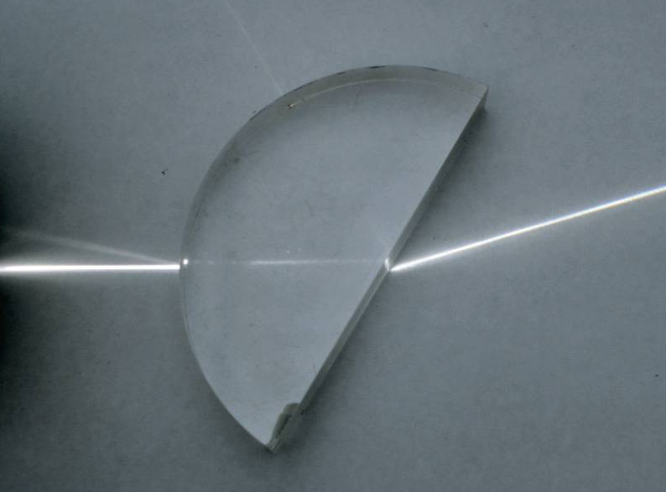
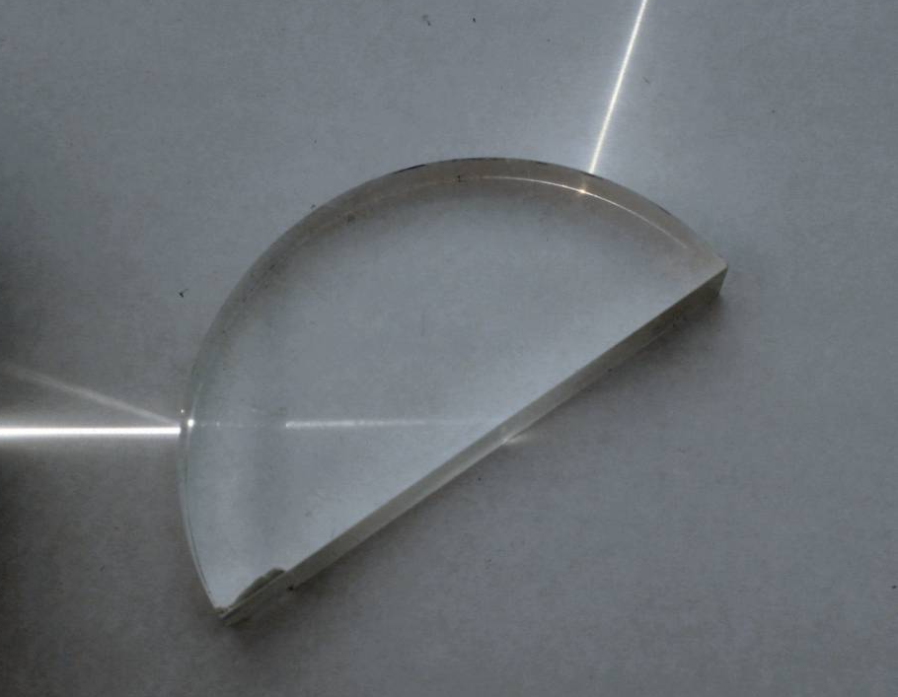

What is total internal reflection?
When a light ray hits the boundary between two materials of different densities (e.g. glass and air), the ray is normally bent or refracted.
This occurs because the speed of light changes in different materials.
If the angle of incidence of the light ray is greater than a specific value, called the critical angle, then the light ray is actually reflected. This is called total internal reflection.
It makes the inner surface of glass act like a perfect mirror.

Slide 37


Total internal reflection – simulation
Notes:
Teacher notes
This virtual experiment illustrates how total internal reflection occurs. It could be used as a precursor to running the experiment in the lab or for revision.

Slide 38
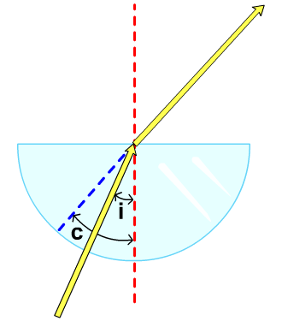
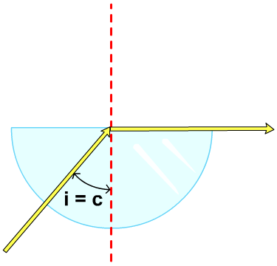
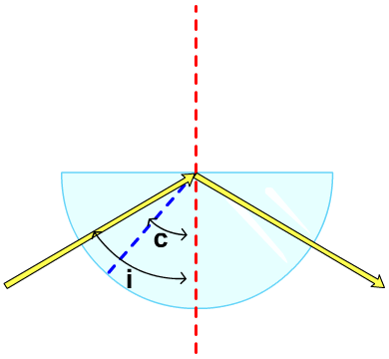
Why is angle of incidence important?
If the angle of incidence is smaller than
the critical angle, then the light ray is refracted.
If the angle of incidence equals the critical angle, then the light ray is refracted along the boundary.
If the angle of incidence is greater than the critical angle, then the light ray is not refracted and total internal
reflection occurs.

Slide 39
Total internal reflection
Total Internal Reflection

Slide 40
Total internal reflection
Total Internal Reflection

Slide 41
Is the critical angle always the same?
The critical angle is the smallest angle of incidence at which total internal reflection occurs.
Different materials have a specific value for the critical angle:
Material
Critical angle
water
49°
acrylic plastic
42°
glass
41°
diamond
24°
Diamond has the lowest critical angle at 24°.
This means that diamond reflects more light than the other materials and accounts for its characteristic sparkle.

Slide 42
Total internal reflection activity
Notes:
Teacher notes
This complete sentences activity could be used a plenary or revision exercise the check students’ understanding of total internal reflection.

Slide 43
Even gets Total Internal Reflection Right
Moreover, this analogy is mathematically equivalent to the actual refraction phenomenon
  can recover Snell’s law: n₁sinθ₁ = n₂sinθ₂
Wheel that hits sidewalk starts to go faster,
which turns the axle, until the upper wheel
re-enters the grass and goes straight again

Slide 44
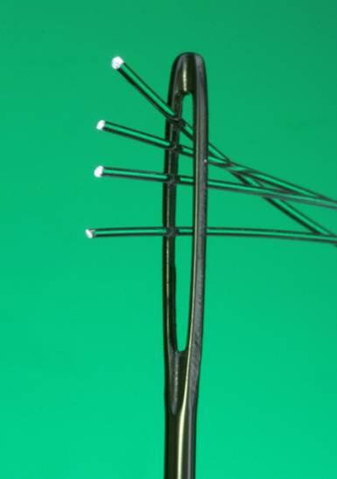
What are optical fibres?
Optical fibres are thin strands of solid glass, about the size of a human hair.
They are widely used in communication, medicine, lighting and as sensors.
The first transatlantic telephone cable to use optical fibres went into operation in 1988.
Optical fibres can transmit light signals at high speed over long distances and are used in phone and internet connections.

Slide 45
Why are optical fibres so important?
Notes:
Teacher notes
This activity provides information about the uses of optical fibres and could be used to start a small group or whole class discussion about the subject.

Slide 46
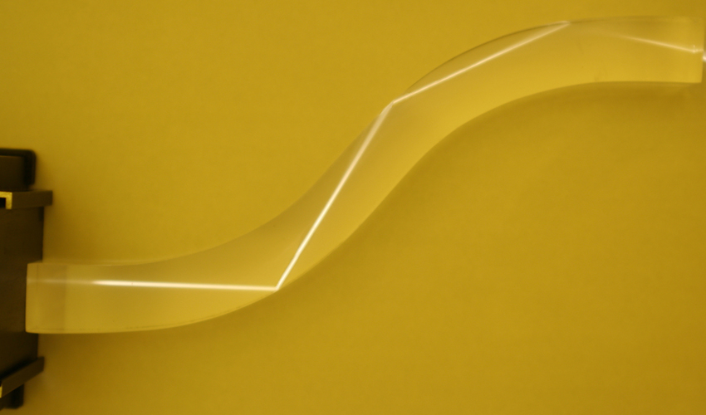
How do optical fibres carry light?
Optical fibres do not have to be straight to carry light and can even carry light around corners.
This curved Perspex rod shows how light travels in an optical fibre.
Light travels through the Perspex rod, and optical fibres, by a
process called total internal reflection.

Slide 47
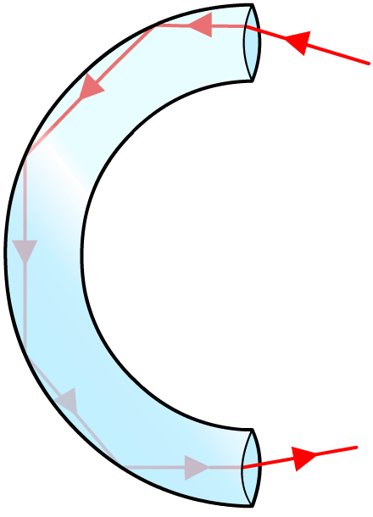
What is total internal reflection?
A ray of light enters the optical fibre.
As the light enters the optical fibre, it is refracted. This means that the direction the light is travelling in changes.
light enters optical fibre
The ray of light hits the wall of the fibre and is totally internally reflected when the angle of incidence is greater than the critical angle.
light leaves optical fibre
The ray of light passes down the optical fibre by repeated total internal reflection.

Slide 48

Total internal reflection
Total Internal Reflection

Slide 49
Some more videos of demos
TIR in Optical Fibre
TIR in Water Tank

Slide 50
Uses of Total Internal Reflection
Optical fibres:
An optical fibre is a long, thin, _______ rod made of glass or plastic. Light is _______ reflected from one end to the other, making it possible to send ____ chunks of information
Optical fibres can be used for _________ by sending electrical signals through the cable. The main advantage of this is a reduced ______ loss.
Words – communications, internally, large, transparent, signal

Slide 51
TIR Demo
Demonstrate the following demos:-
  Optical Fibre Lamp – Just explain.
  TIR in a water demo – Be careful with the laser. Do not point at any students.
  Optical Fibre and Laser demo:- Pass laser through large optical fibre cable and show how it can send coded messages.

Slide 52
What’s in a cable of optical fibres?
Notes:
Teacher notes
This four-stage animation allows students to examine more closely the use of optical fibres for communication. Students could be asked to consider what problems might occur with using underwater cables.

Slide 53
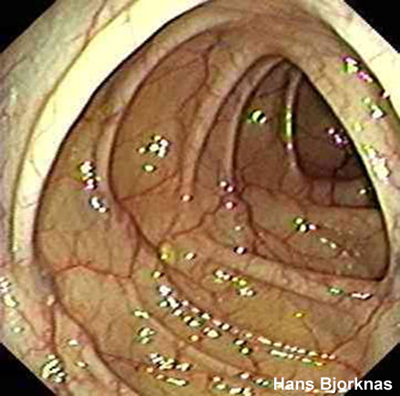
So how can we see inside someone’s body without cutting them open?

Slide 54

How are optical fibres used in medicine?
Optical fibres can be used by doctors to look inside a patient’s body without having to cut them open to check that they are healthy.
The device used for this purpose is called an endoscope. It contains a bundle of optical fibres that are held together and can be inserted into the body.
Light is sent down some of the fibres and the image is reflected back through the other fibres.
Notes:
Photo credit: Hans Bjorknas
Endoscopic image of the inside the large intestine (www.gastrolab.net).

Slide 55
Task
Explain how an endoscope can be used to investigate damage to the digestive system of a patient.

Slide 56
Endoscope
Endoscope

Slide 57
Optical fibres – true or false?
Notes:
Teacher notes
This true-or false activity could be used as a plenary or revision exercise on optical fibres, or at the start of the lesson to gauge students’ existing knowledge of the subject matter. Coloured traffic light cards (red = false, yellow = don’t know, green = true) could be used to make this a whole-class exercise.

Slide 58
Reflection : 4. Reflecting without mirrors
 Copy and complete the ray diagrams using a ruler and pencil.
 Don’t forget to include arrows on your rays!

Slide 59
Reflection and Refraction
Lesson Outcomes
Key Words:- Reflection, Refraction, Density, Normal, Incident Ray, Reflected Ray, Refracted Ray, Angle of Incidence, Angle of Refraction, Total Internal Reflection, Perpindicular, Cladding, Optical Fibres.
To be able to explain how waves get reflected and list a use of this in medicine.
To be able explain how light can be refracted and explain how light bends when it enters light.
To be able to explain how light can be Totally internally reflected and list its uses.

