Slide 1
Technicians List
Radioactivity Demos:-
Radioactive Sources
GM Tube, Counter and Speaker (please set this up before hand)
Tongs
Cork screw to hold Sources
Strong Horse Shoe Magnet (Optional)
Spark Detector:-
Spark Detector
EHT Power Supply
Insulated wires and crocodile clips
Background Radiation Demo (OPTIONAL)
Balloons
Duster Cloth

Slide 2
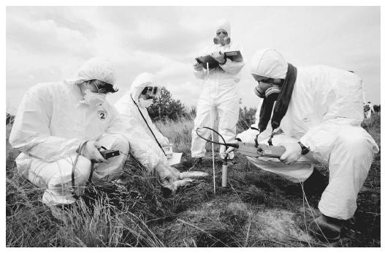
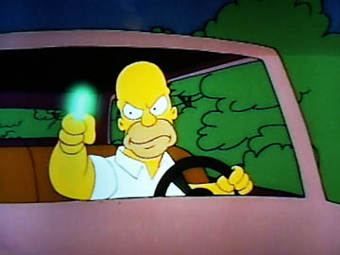
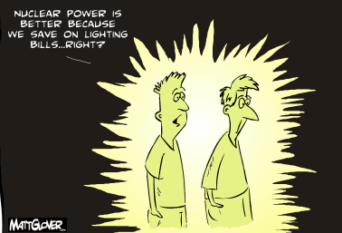
Types of Radioactivity
Connector
Do a quick mind map on everything you know about radiation and radioactivity. Use Key words.
Key Words: Ionising, Penetrating, Cancerous, Electromagnetic, Atomic, Nucleus, Proton, Neutron, Electron, Alpha, Beta, Gamma,

Slide 3
Background Radiation Demo
This demo can be tried but it doesn’t always give good results.
Watch this clip at 2.30 seconds to see instructions.

Slide 4
Types of Radioactivity Lesson Outcomes
Key Words:- Alpha, Beta, Gamma, ionising, proton, neutron, electron, nucleus, penetrating,, lead, aluminium, paper, isotopes
To be able to explain what is meant by background radiation and identify some common sources of it.
To be able to identify three different types of radiation and their main properties and explain what is meant by an isotope of an element.
To be able to explain how to handle radioactive substances safely and problems associated with Radioactive waste

Slide 5
Demonstration and Big Picture
Set up the GM tube and just leave it turned on in a corner of the room or on the teacher’s desk.
Explain to students that each reading on the GM tube is a radioactive particle entering the tube.
Ask these questions?
What are these particles?
Where are they coming from?
What causes them?
Are they harmful to us?

Slide 6
Background Radiation
There is radiation around us all the time.
It is there from the day you are born to the day you die.
It comes to us from a number of different sources:-

Slide 7
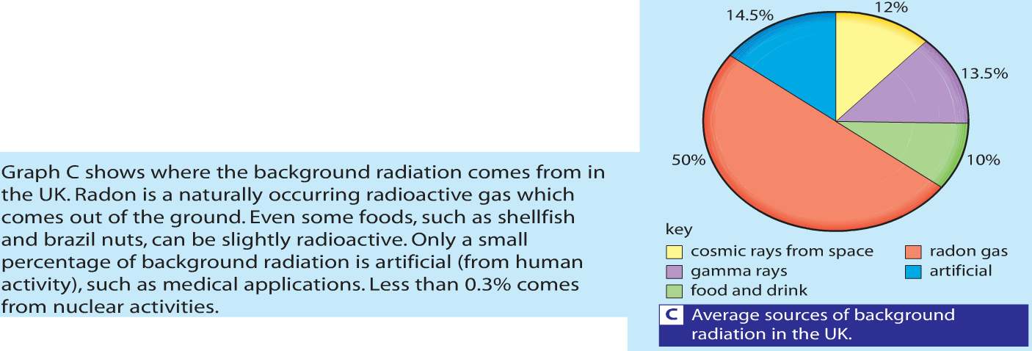

Slide 8
Types of Radioactivity Lesson Outcomes
Key Words:- Alpha, Beta, Gamma, ionising, penetrating, proton, neutron, electron, nucleus, penetrating, ionising, lead, aluminium, paper, isotopes
To be able to explain what is meant by background radiation and identify some common sources of it.
To be able to identify three different types of radiation and their main properties and explain what is meant by an isotope of an element.
To be able to explain how to handle radioactive substances safely and problems associated with Radioactive waste

Slide 9
What is Radioactivity?
Before we can learn about Radioactivity we have to first learn about atoms:
What do you know about the structure of an atom?

Slide 10
The structure of the atom
ELECTRON – negative, mass nearly nothing
PROTON – positive, same mass as neutron (“1”)
NEUTRON – neutral, same mass as proton (“1”)

Slide 11
The structure of the atom
Particle | Relative Mass | Relative Charge
Proton | 1 | +1
Neutron | 1 | 0
Electron | 0 | -1
MASS NUMBER = number of protons + number of neutrons
4
He
SYMBOL
2
PROTON NUMBER = number of protons (obviously)

Slide 12
What are isotopes?

Slide 13
Isotopes
Atoms of the same element (same Atomic Number) but with different mass numbers.
How can this be?
Nuclear symbol:
Mass #
12
6
C
Atomic #
Hyphen notation: carbon-12
Courtesy Christy Johannesson www.nisd.net/communicationsarts/pages/chem
Notes:
Each isotope has a different number of neutrons.

Slide 14
Isotopes
Neutron
+
+
+
Electrons
Nucleus
+
+
+
Proton
Nucleus
Nucleus
Proton
+
+
+
Neutron
Carbon-12
+
+
Neutrons 6
Protons 6
Electrons 6
Electrons
+
Carbon-14
Neutrons 8
Protons 6
Electrons 6
Nucleus
Notes:
The chemistry of each element is determined by its number of protons and electrons.
In a neutral atom, the number of electrons equals the number of protons.
Symbols for elements are derived directly from the element’s name.
Nuclei of atoms contain neutrons as well as protons.
The number of neutrons is not fixed for most elements, unlike protons.
Atoms that have the same number of protons, and hence the same atomic number, but different numbers of neutrons are called isotopes.

Slide 15
⁶Li ⁷Li
3 p⁺
3 n⁰
3 p⁺
4 n⁰
2e– 1e–
2e– 1e–
Neutron
Neutron
Electrons
+
Electrons
+
Nucleus
+
+
Nucleus
+
+
Proton
Proton
Nucleus
Nucleus
Lithium-6
Lithium-7
Neutrons 3
Protons 3
Electrons 3
Neutrons 4
Protons 3
Electrons 3

Slide 16
Which isotope is real?
Isotopes that occur most abundantly in nature are included in the periodic table. Such as Carbon 12 and Uranium 238.
Other examples of these atoms are not included in the periodic table such as Carbon 14 and Uranium 235.

Slide 17
100
Which isotope of Chlorine is included in the Periodic Table?
Mass spectrum of chlorine. Elemental chlorine (Cl₂) contains
only two isotopes: 34.97 amu (75.53%) and 36.97 (24.47%)
90
80
Cl-35
70
60
50
Abundance
40
30
Cl-37
20
10
0
34
35
36
37
Mass
Notes:
Mass spectrum of chlorine. Elemental chlorine (Cl₂) contains
only two isotopes: 34.97 amu (75.53%) and 36.97 (24.47%)

Slide 18
Isotopes
Most isotopes are unstable and are therefore radioactive.

Slide 19
Introduction to Radioactivity
Some substances are classed as “radioactive” – this means that they are unstable and continuously give out radiation:
Radiation
The nucleus is more stable after emitting some radiation – this is called “radioactice decay” and the activity is measured in “Becquerels (Bq)”.

Slide 20
Why is Radiation Dangerous?

Slide 21
Ionisation
Radiation is dangerous because it “ionises” atoms – in other words, it turns them into ions by “knocking off” electrons:
Alpha radiation is the most ionising (basically, because it’s the biggest). Ionisation causes cells in living tissue to mutate, usually causing cancer.

Slide 22
Radiation Demo
Use radioactive sources to demonstrate range in air and penetrating power. Use spark counter to demonstrate ionising power
Range in Air
Penetrating Power Demo
Spark Counter Demo – 12 min 47 sec in the video here
Also watch this link for further demonstration and animations.
Get students to discuss what each demonstration shows about the property of that particular radiation.

Slide 23
Blocking Radiation
Each type of radiation can be blocked by different materials:
α
β
γ
Sheet of paper
Few mm of aluminium
Few cm of lead
Which radiation is the most penetrating? Which is the least?

Slide 24
Types of radiation
1) Alpha (α) – an atom decays into a new atom and emits an alpha particle (2 protons and 2 ______ – the nucleus of a ______ atom)
Unstable nucleus
New nucleus
Alpha particle
2) Beta (β) – an atom decays into a new atom by changing a neutron into a _______ and electron. The fast moving, high energy electron is called a _____ particle.
Beta particle
Unstable nucleus
New nucleus
3) Gamma – after α or β decay surplus ______ is sometimes emitted. This is called gamma radiation and has a very high ______ with short wavelength. The atom is not changed.
Unstable nucleus
New nucleus
Gamma radiation
Words – frequency, proton, energy, neutrons, helium, beta

Slide 25
Types of Radioactivity Lesson Outcomes
Key Words:- Alpha, Beta, Gamma, ionising, penetrating, proton, neutron, electron, nucleus, penetrating, ionising, lead, aluminium, paper, isotopes
To be able to explain what is meant by background radiation and identify some common sources of it.
To be able to identify three different types of radiation and their main properties and explain what is meant by an isotope of an element.
To be able to explain how to handle radioactive substances safely and problems associated with Radioactive waste

Slide 26
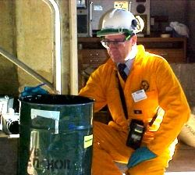
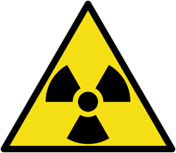
Handling Radioactive Materials
Safety measures:
Keep your distance
Minimise exposure time
Protective clothing
Careful labelling

Slide 27
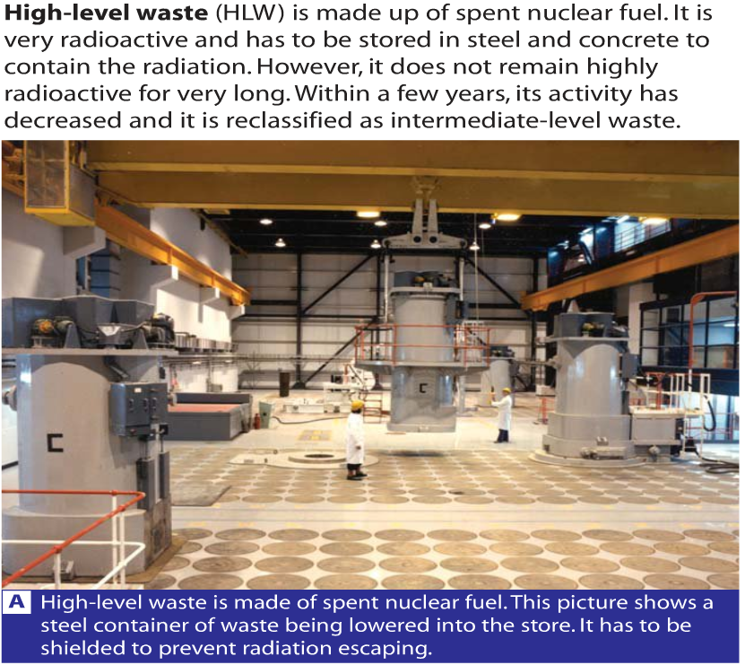

Slide 28
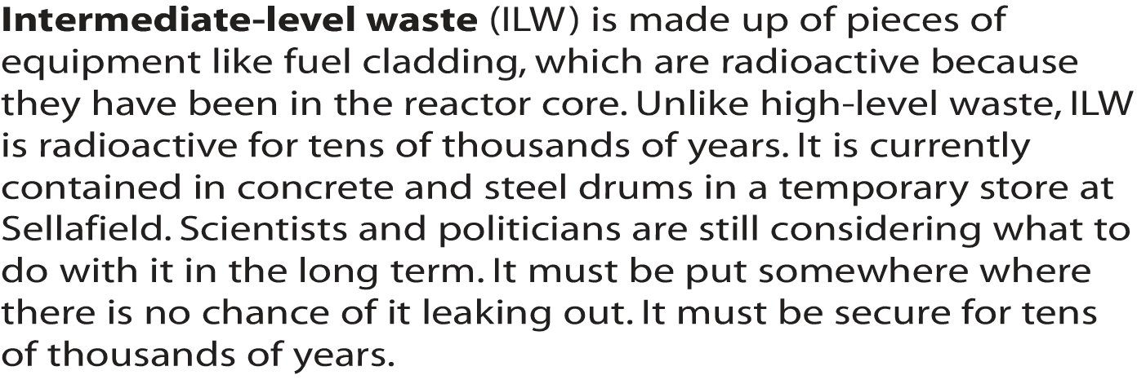

Slide 29
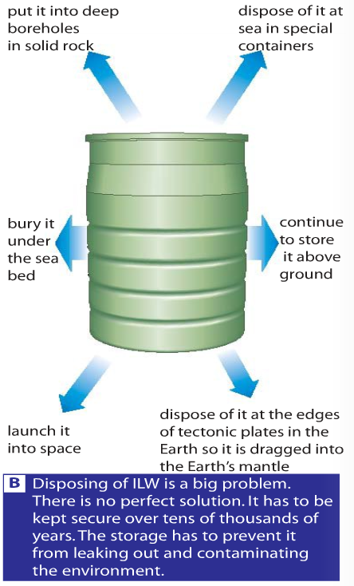

Slide 30
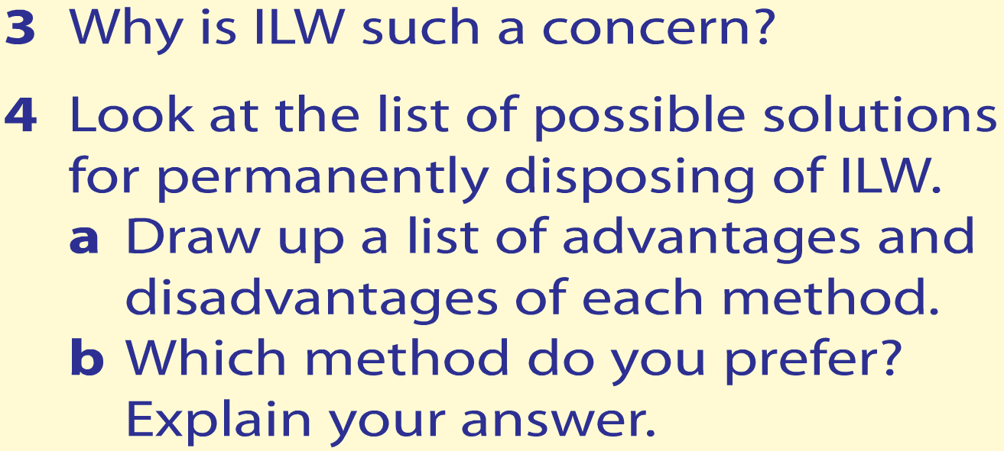

Slide 32
Why do we care?*
Remains radioactive for a long time
Terrorist risk
Risk of ground water exposure
Acceptable radioactive level may change over time (becomes more radioactive over time)

Slide 33
Types of Radioactivity Lesson Outcomes
Key Words:- Alpha, Beta, Gamma, ionising, penetrating, proton, neutron, electron, nucleus, penetrating, ionising, lead, aluminium, paper, isotopes
To be able to explain what is meant by background radiation and identify some common sources of it.
To be able to identify three different types of radiation and their main properties and explain what is meant by an isotope of an element.
To be able to explain how to handle radioactive substances safely and problems associated with Radioactive waste

Slide 34
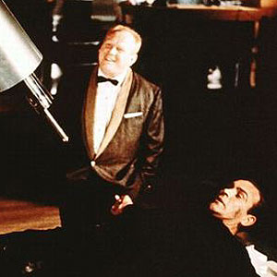
Plenary
Goldfinger has captured James Bond and has him strapped to a machine.
He is feeling generous today and offers James a chance to kill himself quickly by swallowing a radiation pill.
Which type of radiation should he swallow in order to survive? Explain your reasons for your answer.

