Slide 1
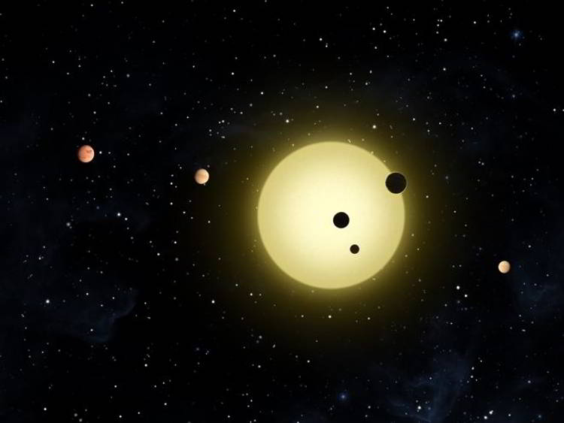
Exploring our Solar System

Slide 2
Technician’s List
Circular Motion Demos:-
  Penny and Hanger kit
  Whirling water bucket demo with special platform and plastic beaker
  OPTIONAL:- Sparkler in a drill Demo
Solar System Model (orrey)

Slide 3
Exploring our Solar System
Learning Outcomes
To be able to explain our position in the Universe and that all objects are orbiting other objects in the Universe describing the force for this motion.
To be able to recall some of the main features of the solar system like where the planets are the relative distances between them. To be able to explain the similarities and differences between planets and comets.
To be able to explain the major problems with Manned Space Travel.

Slide 4
Outcomes From the Spec
Foundation Paper
You should now be able to..
Know that: Earth is one of a number of planets that orbit the Sun: the Moon orbits Earth; Earth orbits the Sun and the relative positions of Earth, Sun and planets
Know that the Universe consists of: stars and planets, comets and meteors, black holes, large groups of stars called galaxies
Describe why stars can be seen even though they are far away
Describe that gravitational force determines the motion of planets and satellites
Higher paper
Know the relative positions of planets, stars, comets, meteors, galaxies and black holes
Know that circular motion requires a centripetal force and that gravity provides the centripetal force for orbital motion

Slide 5
The Universe
Europe
FHS
Star
Sun
Ealing
Moon
Planet
Galaxy
Universe
Earth
Asteroid
Can you put them in order of size?
Southall

Slide 6
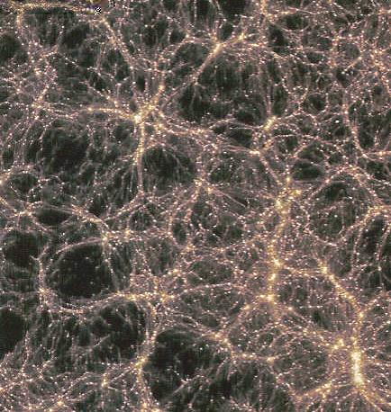
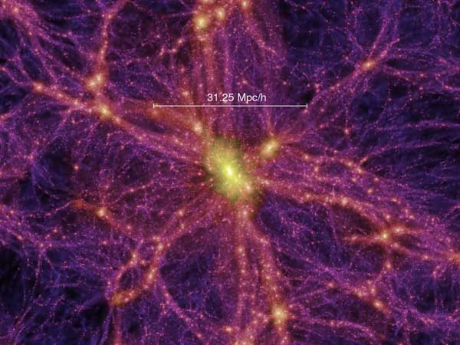
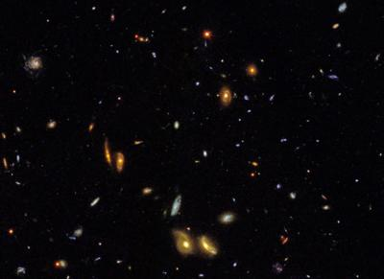
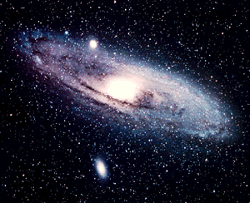
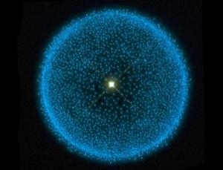
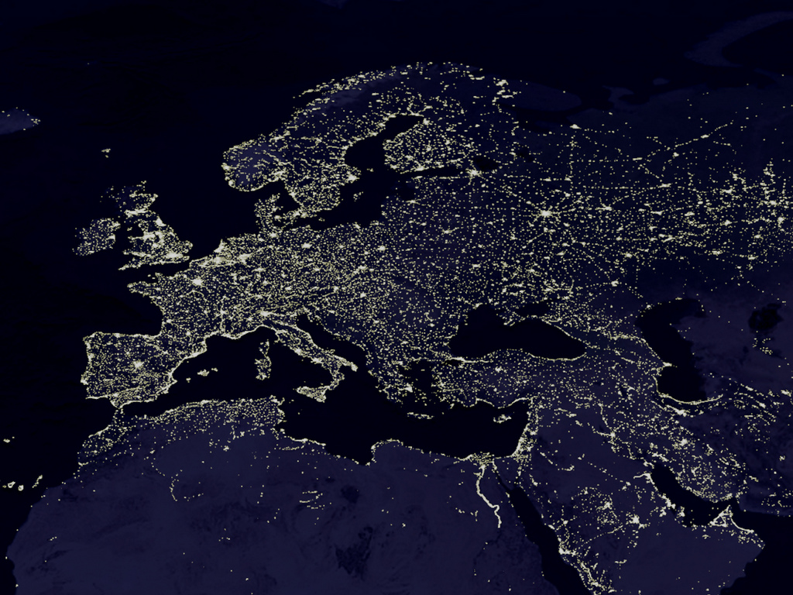
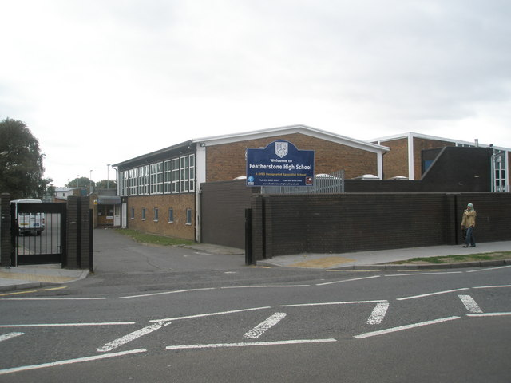
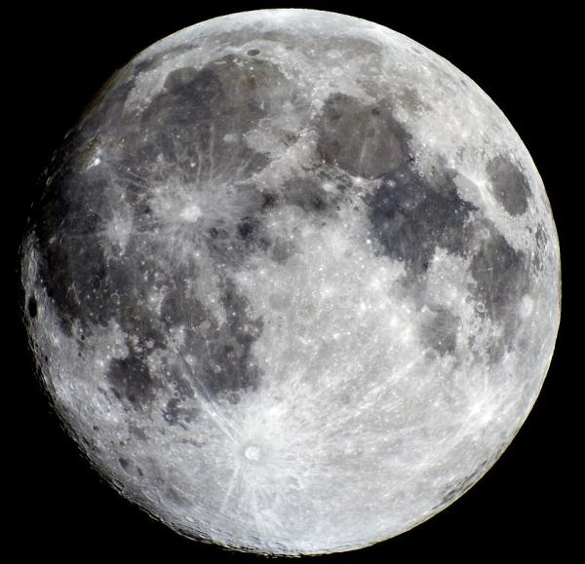
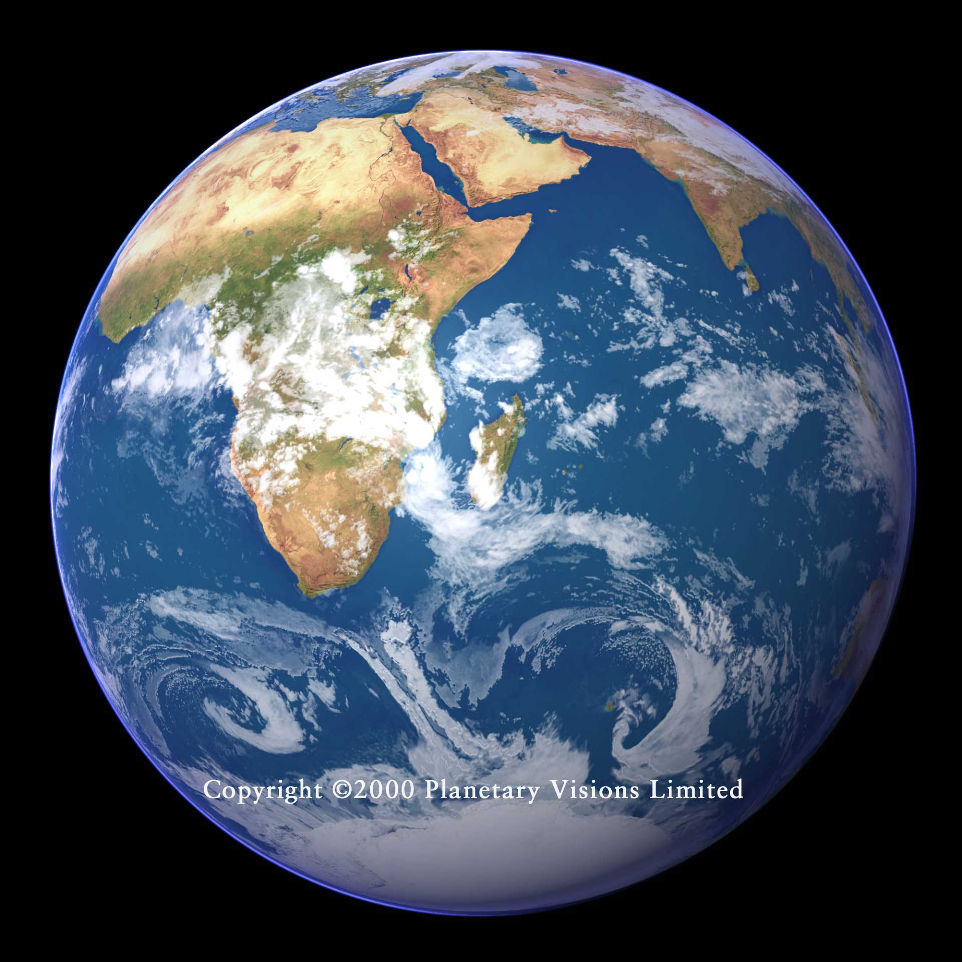
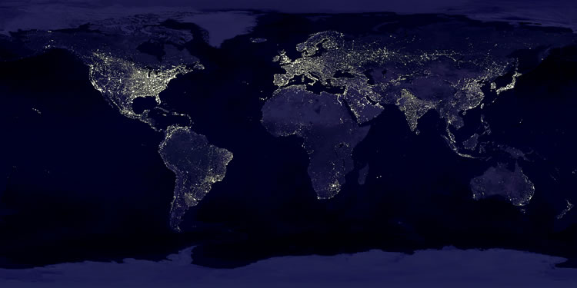
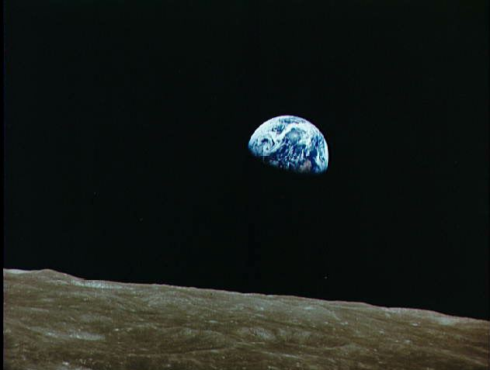
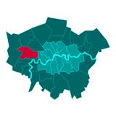
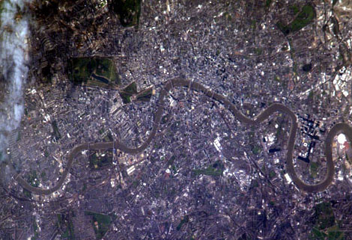
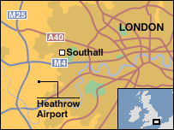
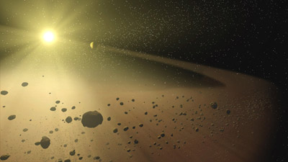
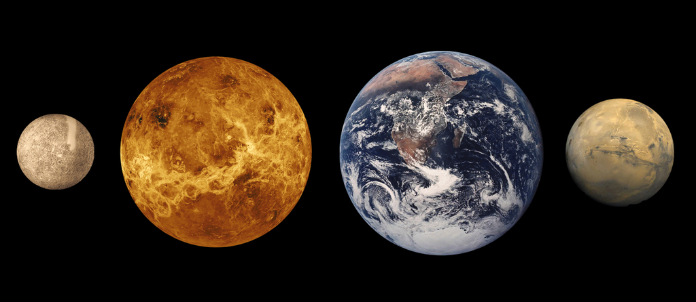
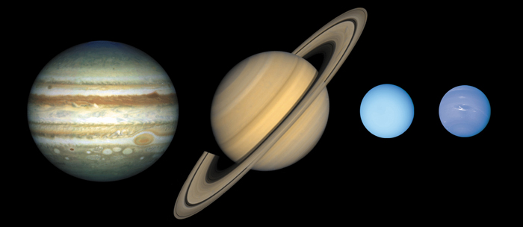
The Asteroid Belt
The Inner Rocky Planets
Virgo Galaxy Super
Cluster
The Gas Giants
Earth Rise as seen by astronauts on the Moon
The outermost edge of our Solar System called the Oort Cloud
Picture of Deep Space taken by Hubble. Each dot is a galaxy
Virgo Galaxy Super
Cluster
Our Galaxy the Milky Way
The Moon

Slide 7
http://workshop.chromeexperiments.com/stars/ (Run in Google Chrome)

Slide 8
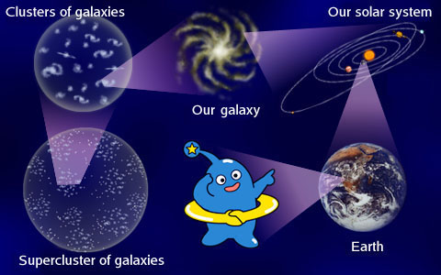
Universe

Slide 9
Scale of the Universe

Slide 10
Our universal address would be:
Featherstone high School,
11 Montague Waye,
Southall,
UB2 5HF,
England,
Europe,
Earth,
Sol,
Milky Way Galaxy,
Andromeda Cluster,
The Universe.
Universe
Cluster
Galaxy
Star and Sun
Planet and Earth
Moon
Asteroid
Meteor

Slide 11
Some basic definitions
Solar System:- Collection of planets and asteroids that orbit a star called Sun. It is located in the Milky Way Galaxy.
Galaxy:- A collection of millions of stars that orbit each other in space. Examples of galaxies are Milky Way galaxy and the Andromeda Galaxy.
Stars:- Luminous objects in the Universe that produce their own heat and light through Nuclear Fusion reaction in their core.
Planets:- Non Luminous objects in the Universe which orbit most stars.

Slide 12
In this section we will answer some big questions
How many stars are there in the Universe?
How big is the Universe?
What does the Solar System Consist of?

Slide 13
There are a collection of videos coming up which are best viewed in a blacked out room in darkness.
Students can make some notes after the videos have finished.

Slide 14
How many stars are there in the Universe?
http://www.youtube.com/watch?v=KuA5FafFUKg
Carl Sagan (optional if there is time):-
  http://www.youtube.com/watch?v=sJ_tZr0D2pk
  http://www.youtube.com/watch?v=5Ex__M-OwSA
There are 10¹¹ stars in every galaxy in the Universe.
There are 10¹¹ galaxies in the Universe.
How many stars are there in the Universe?

Slide 15
How big is the Universe?
Powers of 10 video - http://www.youtube.com/watch?v=qxXf7AJZ73A
  OR
Everything in the known Universe video - http://www.youtube.com/watch?v=17jymDn0W6U

Slide 16
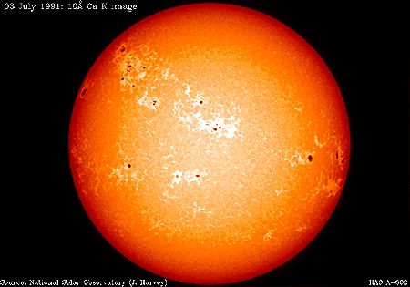
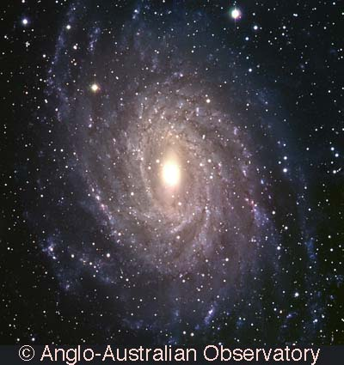
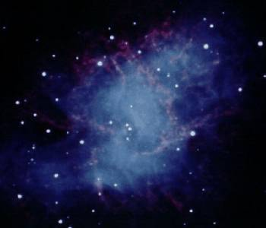
Solar systems, galaxies and the Universe
(Basically, everything in the universe orbits around something else)
OUR SUN is one of millions of stars that orbit the centre of…
THE MILKY WAY, which is one of a billion galaxies that orbit AND move away from the centre of…
THE UNIVERSE

Slide 17
Where do they all sit?
Universe
Galaxies
Black holes
Solar system
Planets
Moons
Stars
Comets, Meteors

Slide 18
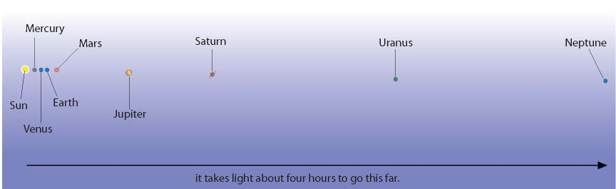
World(s) order
…or any electromagnetic wave

Slide 19
Elliptical Orbits
Ellipse

Slide 20
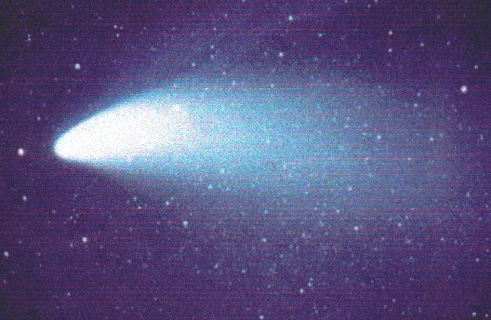
Comets
Comets are balls of dust and frozen gas. They have very elliptical orbits:
As the comet approaches the sun gases evaporate from it, forming a “tail”. This tail always faces AWAY from the sun. The comet also goes faster near the sun.

Slide 21
The Earth is kept in orbit by 2 things…
This is called a “centripetal force”
Gravity
…and by the fact that it is moving at a high velocity

Slide 22
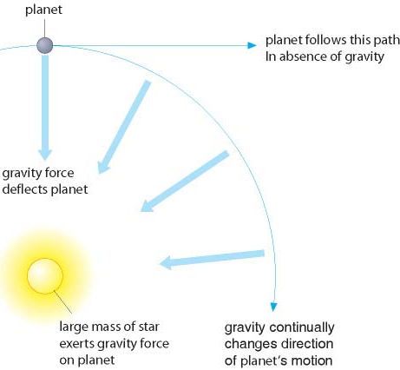
Gravity
The suns pull (gravity) keeps all the planets in orbit
If there was no gravity the planets would keep going in a straight line
This is called a centripetal force (the opposite to what you feel in a car)

Slide 23
Circular motion
Any circular motion requires a centripetal force
This force acts towards the centre of the rotation and must be constant to maintain a constant speed and distance
Gravitational attraction provides the centripetal force for a planet

Slide 24
Circular Motion Demos
Hanger and penny demo
Whirling bucket demo (can be done as a practical but best done outside)
OPTIONAL:- Sparkler in a drill demo

Slide 25
Solar System
A quick quiz on the...

Slide 26
Solar System Quiz
Which is the:-
  Largest Planet in the Solar System?
  Warmest Planet in the Solar System?
  Largest Satellite in the Solar System?
  Furthest Planet in the Solar System?
Where is the Asteroid belt located?
Why is Pluto no longer considered to be a Planet in the Solar System?

Slide 27
Our Solar System
Mercury
Venus
Earth
Mars
Jupiter
Saturn
Uranus
Neptune
Pluto
My Very Easy Method Just Speeds Up Naming Planets

Slide 28
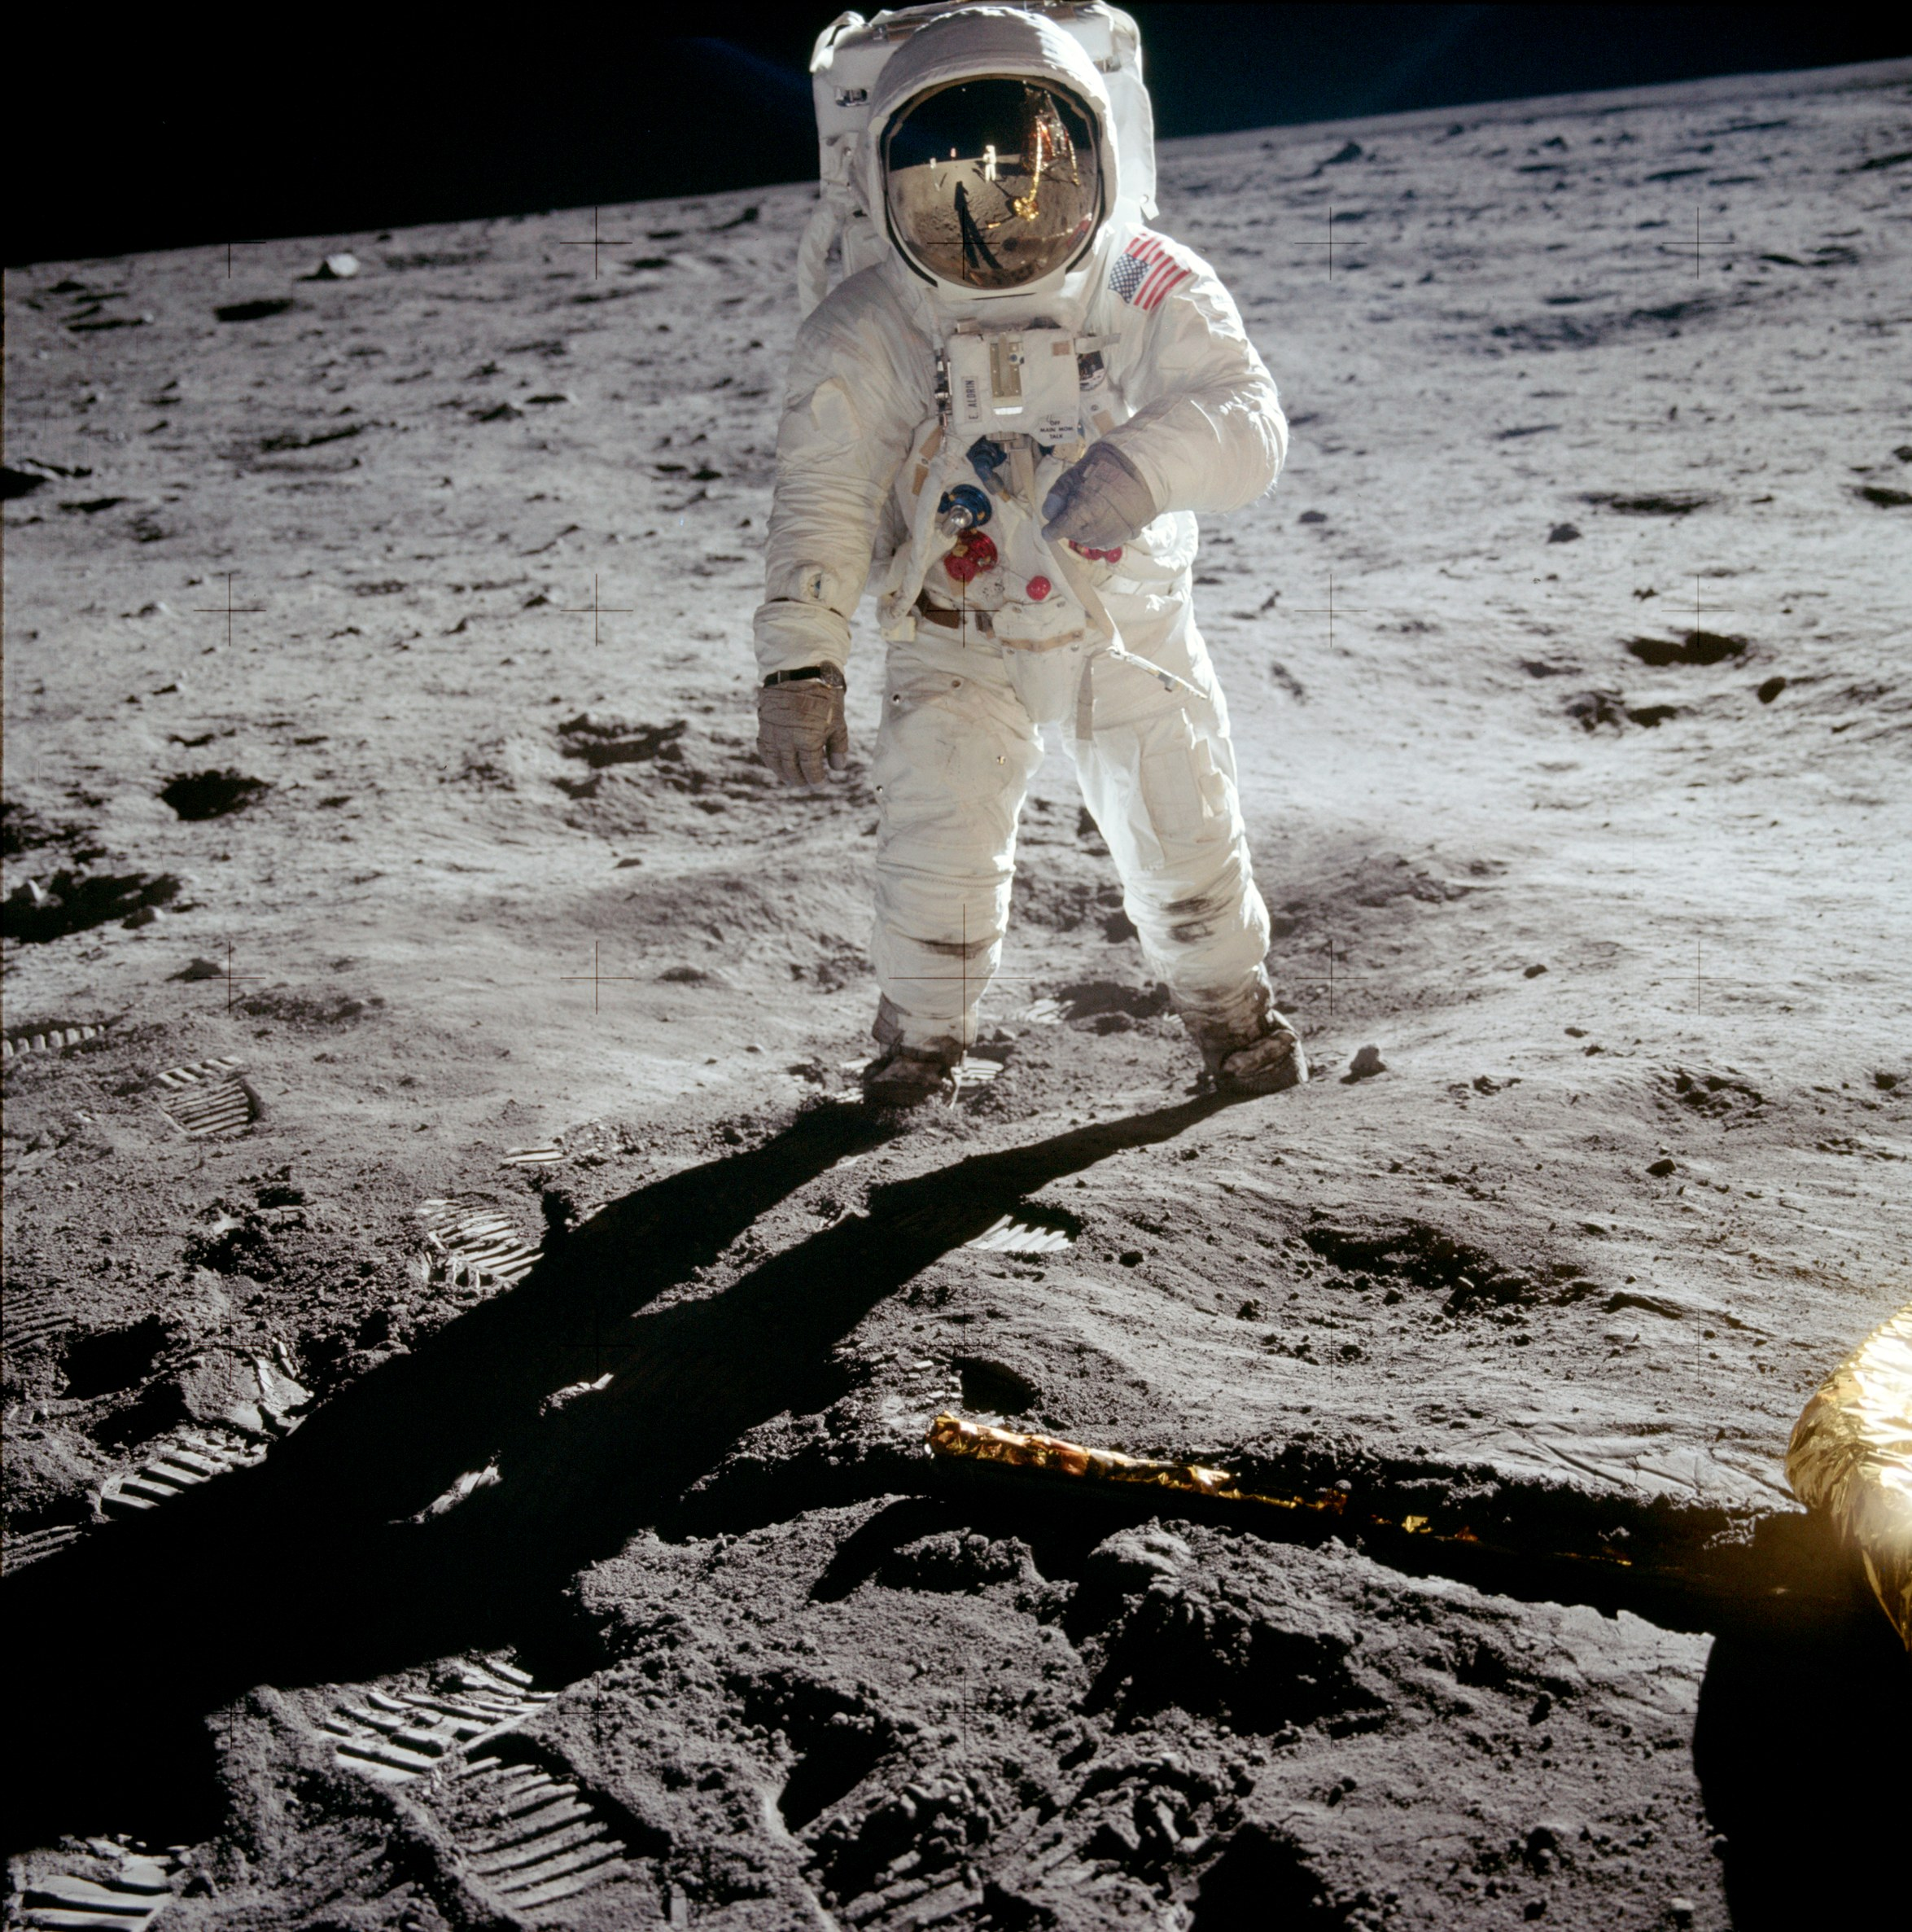
Manned Space Exploration

Slide 29
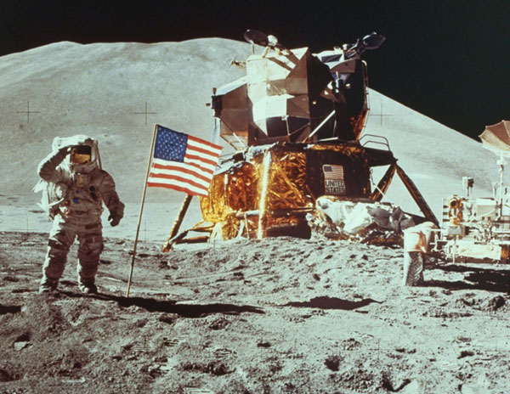
A Short History

Slide 30
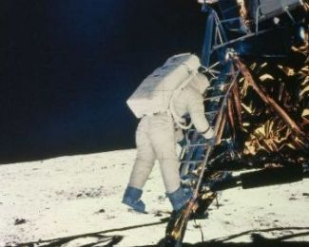
On 11 July 1969 two Astronauts landed on the Moon
This is one small step for man … one giant leap for mankind

Slide 31
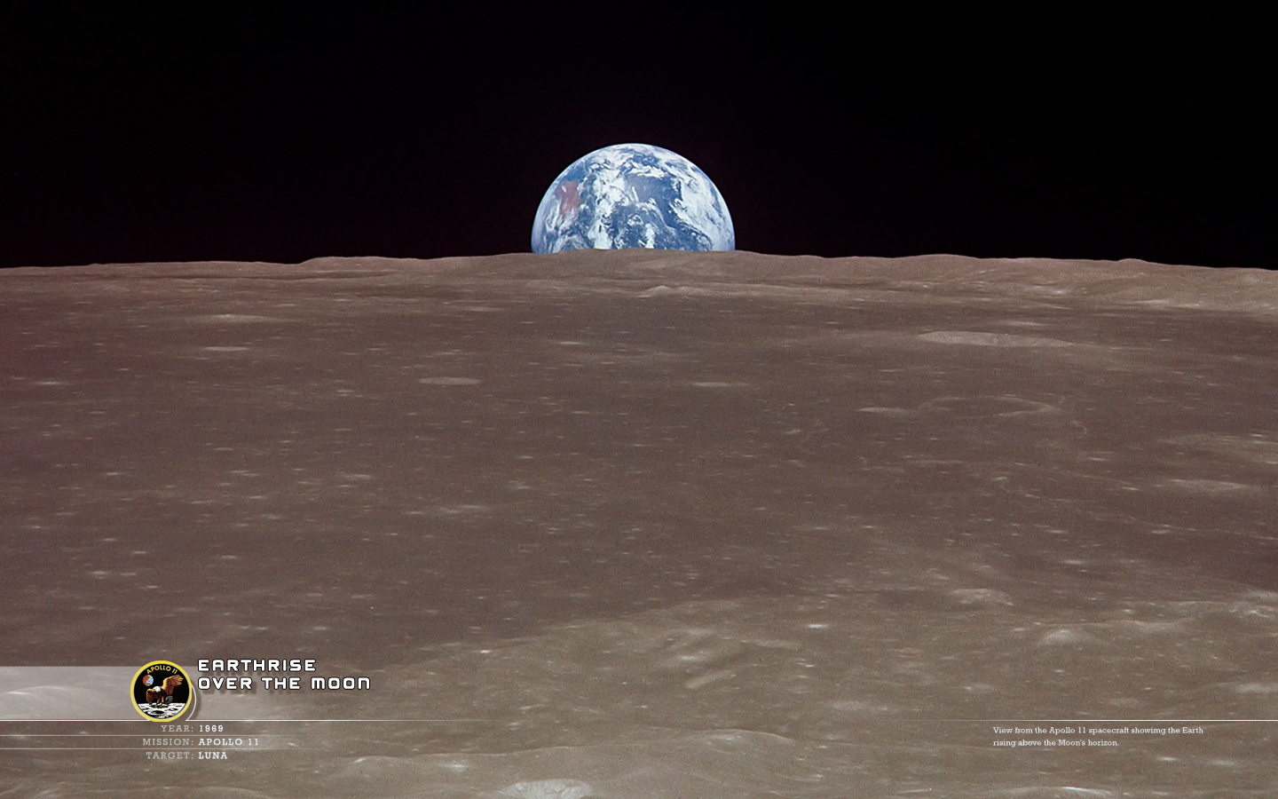
This is the furthest Mankind has been in outer space.

Slide 32
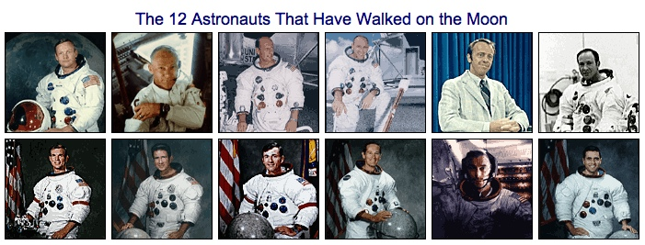
In total 12 men have walked on the moon. They were all Americans.

Slide 33
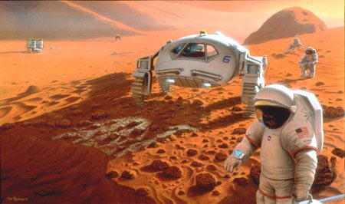
At this time most people believed that by the year 2000 man would colonise the Moon and landed on Mars.

Slide 34
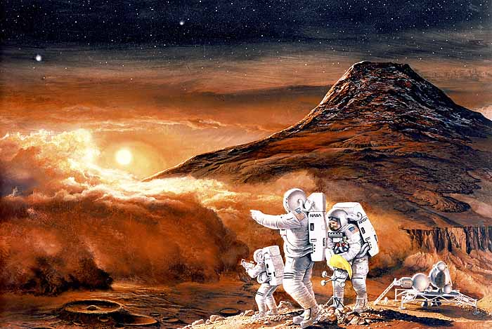
Why has this not happened?

Slide 35
Problems with Space
It’s Huge!!

Slide 36
The speed of light is the fastest speed that could EVER be achieved.
The speed of light is 300 000 km per SECOND!!
(That’s 186 000 miles per second)
Light takes 2 seconds to reach the Earth from the moon
- it takes it 8 minutes to reach the Earth from the Sun

Slide 37
If you were in a spaceship that travelled at the speed of light and you started a journey from the Sun it would take:
about 3 minutes to reach Mercury,
5 minutes to reach Venus,
8 minutes to reach the Earth,
5¹/₂ hours to reach Pluto,
4 years to reach the next star,
5000 years to reach the edge of the galaxy,
50 000 years to reach the next galaxy,
500 000 years to reach the next Cluster!!

Slide 38
Real rockets don’t travel at the speed of light, they travel MUCH slower.
The Apollo missions took 4 days to reach the moon - at the speed of light it would have taken 2 seconds!!
These rockets were travelling roughly 200 000 times slower than light.
At this speed it would take 125 YEARS to get to Pluto!

Slide 39
How far…
Earth is 150 000 000Km away from the sun.
Light travels 300 000km each second
So light takes about 8minutes to reach Earth.
Very large distances in space are measured in light years- the distance that light travels in 1 year (9 500 000 000 000 000 Km)
The next star nearest to Earth (after the sun) is called Proxima Centauri and is 4.22 light years away.

Slide 40
Light years
A light year is how far light travels in a year
Distance = Speed x time
= 300,000,000 x 60 x 60 x 24 x 365.25
= 9.47 x 10¹⁵m
A light year is a measure of distance not time!

Slide 41
Calculating how long light takes…
Light travels at a speed of 300 000 000 m/s.
How long does light from the Sun take to reach Earth? (distance of Earth from the Sun is 150 million km)
Distance from earth to the sun = 150 000 000 000 meters
300 000 000
150 000 000 000
= 500 seconds (/60 =8.3 minutes)

Slide 42
Problems going Manned?
Need enough fuel
Takes a long time to get anywhere (vast distances in space)
Low gravity can affect health
Prolonged exposure to cosmic rays
Difficult to maintain a stable atmosphere
Large amounts of food and water required
Keeping warm! (The average temperature of space is -270ºC)

Slide 43
Unmanned
Can withstand large temperatures
Don’t need food, water or oxygen
Can send back information on
  Temperature
  Magnetic fields
  Radiation levels
  Gravity
  Atmosphere and Surroundings

Slide 44
So should we go unmanned?
Yes
Cost
  cheaper than going manned, less fuel needed, no food or complex environmental issues
Safety
  no risk of fatality in space
No
Reliability
Maintenance
  If there is no one to repair the spacecraft it could become unusable after a simple fault

Slide 45
Space Travel
Advantages
Disadvantages
Manned space
travel
Unmanned space
travel

