Slide 1
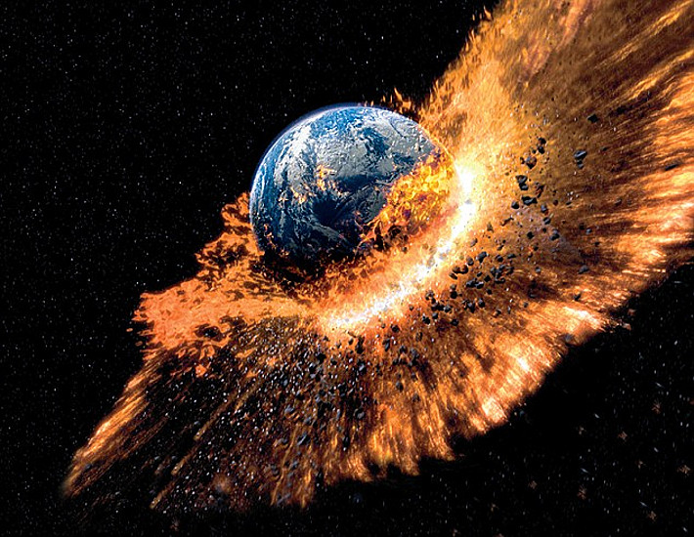
P2g – Threats to Earth

Slide 2
Homework
Compile a poster on one of the following topics:-
The Formation of the Moon
Dangers of NEO’s
How did the Dinosaurs become extinct?

Slide 3
P2g Threats to the Earth
Learning outcomes
To be able to discuss and explain the evidence to prove that asteroids, meteors or comets have collided with the Earth in the past
To explain the threats from Near Earth Objects.
To be able to explain the origin of the Moon.
Keywords: NEO, craters, extinct, asteroids, meteors, meteorite, comet, asteroid, asteroid belt, orbit.
Starter 1 – Your thoughts
What happened to the Dinosaurs? How did they become extinct? How do we know?

Slide 4
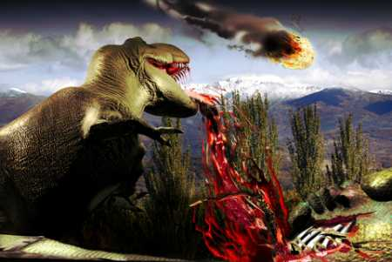
What killed the Dinosaurs
Dinosaurs were killed off by a giant meteorite that collided with the Earth.

Slide 5
How do we know that meteorites have collided with the Earth before?
Because of meteor craters

Slide 6
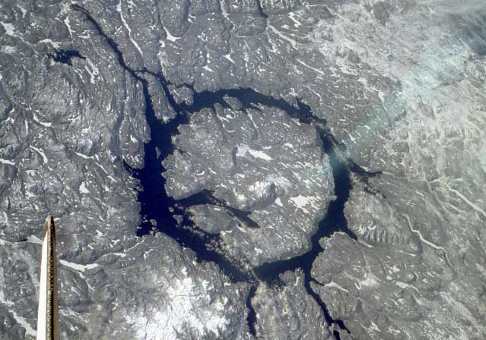

Slide 7
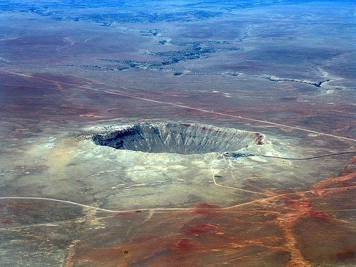

Slide 8
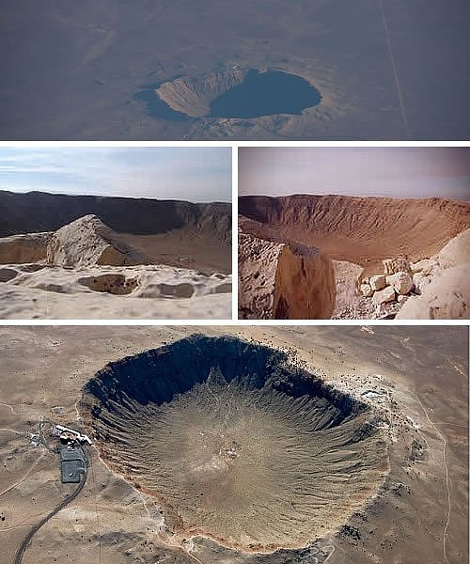

Slide 9
Manicouagan Crater in northern Canada
one of the oldest impact craters known

Slide 10
49,000 years ago a large nickel-iron meteorite 150 ft across weighing several hundred thousand tons and traveling at a speed of 40,000 miles per hour, hit Earth.
The result of this collision can be found in the Arizona Desert and is called the Barringer Crater. This is the best preserved impact crater ever.
Click Here for video.

Slide 11
Watch this clip 20 minutes in
Students to make detailed notes

Slide 12
Task 1
What evidence is there to support the theory that rocks have collided with the Earth before?
(6 marks)

Slide 13
Task 1 Answers
Grade C:-
Mention about meteor craters. Good description that some of these still remain and are well preserved.
Grade B:-
Explanation about quartz crystals being formed at the bottom of most meteor craters which can only have been formed in high speed collisions.
Grade A:-
All of Grade B + mention about Iridium layer in the base of meteor crater. Iridium is very rare on Earth but very common in Asteroids, Meteorites and Comets.

Slide 14
P2g Threats to the Earth
Learning outcomes
To be able to discuss and explain the evidence to prove that asteroids, meteors or comets have collided with the Earth in the past
To explain the threats from Near Earth Objects.
To be able to explain the origin of the Moon.
Keywords: NEO, craters, extinct, asteroids, meteors, meteorite, comet, asteroid, asteroid belt, orbit.
Starter 1 – Your thoughts
What happened to the Dinosaurs? How did they become extinct? How do we know?

Slide 15
So what caused these craters?
Comets?
Meteors?
Asteroids?
What’s the difference?

Slide 16
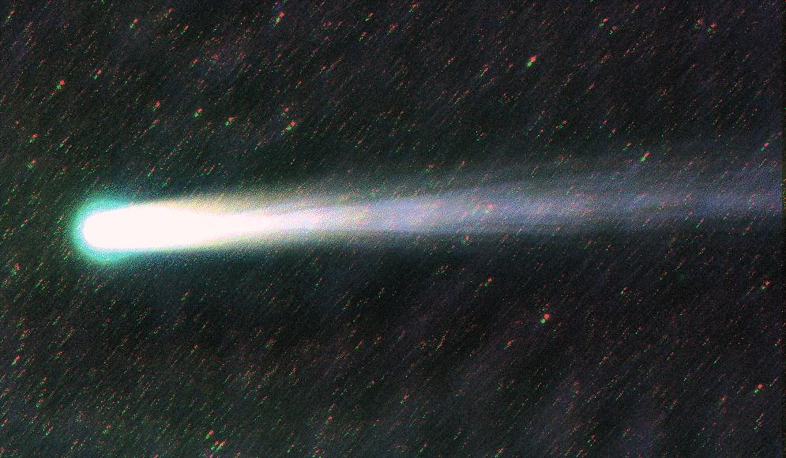
Comets
Have a core of frozen gas and dust and an elliptical orbit around the Sun
Size: up to 20km in diameter
What makes them easy to see?
As they approach the Sun gases evaporate to form the tail

Slide 17
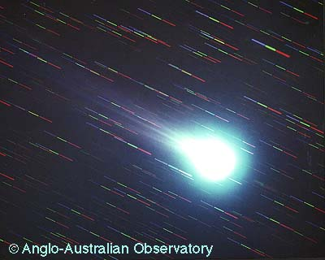
Halley’s Comet Reappears every 76 years Image from 1986

Slide 18
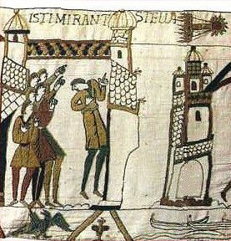
Seen by people in 1066 and recorded in the Bayeux Tapestry

Slide 19
Hale-Bopp as seen from Craig County, VA in 1997

Slide 20
Hale-Bopp as seen from Alexandria, VA in 1997

Slide 21
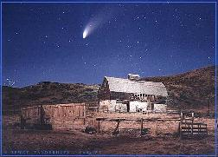
Hale-Bopp as seen from Wyoming in 1997

Slide 22
Comets
Comets are balls of rock and ice, with trails of debris blown outward by the Sun
They have highly elliptical orbits and speed up as they approach the sun
The trajectories of observed objects can be predicted accurately
If an asteroid (or comet) on a collision course with Earth is spotted early enough, it may be possible to alter the trajectory of the asteroid

Slide 23
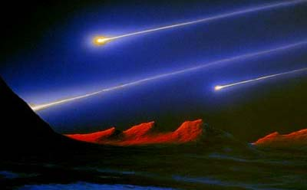
Meteors (Shooting stars)
Fragments of dust and rock
Size: Much smaller than comets
What makes them easy to see?
As they enter the earth’s atmosphere they burn up due to friction giving out light.

Slide 24
asteroids
Lumps of rocks left over from the formation of the solar system
Orbit the Sun in the asteroid belt (between Mars and Jupiter)
Why is the asteroid belt there?
Jupiter is so huge it’s gravitational pull stops the rocks joining together to form planets

Slide 25
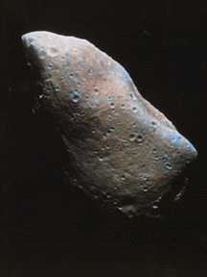
The asteroid Gaspra, found in the Asteroid Belt between Mars & Jupiter

Slide 26
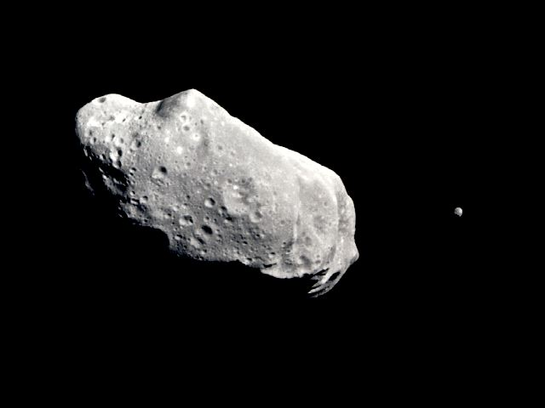
Asteroid Ida with it’s moon Dactyl

Slide 27
Asteroids
Asteroids are large rocks left over from the formation of the Solar System
They are mostly between the orbits of Mars and Jupiter
Asteroids (large rocks) have collided with the Earth in the past causing:
- craters,
- ejection of hot rocks,
- widespread fires,
- sunlight blocked by dust,
- climate change,
- species extinction

Slide 28
Collisions?
The evidence for past collision on Earth includes:
- craters
- layers of unusual elements in rocks
- sudden changes of fossil numbers between adjacent layers of rock.

Slide 29
Rocks
Asteroids are small ______________ which orbit the ______________, mainly between ______________ and ______________. Occasionally, a long time ago, ______________ are thought to have struck ______________, forming large ______________ and huge amounts of ______________ and ______________ vapour. An enormous asteroid is believed to have hit ______________ 65 ______________ years ago, leading to the ______________ of the ______________. ______________ could not penetrate the ______________ so ______________ fell, causing ______________ change.
Sun
Mars
Jupiter
Asteroids
Earth
craters
dust
water
Earth
million
extinction
dinosaurs
sunlight
atmosphere
temperatures
climate
Asteroids atmosphere climate comets
craters dinosaurs dust Earth
extinction Jupiter Mars meteors
million Neptune rocks Saturn
snowballs Sun sunlight temperatures
water

Slide 30
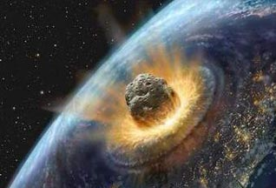
NEOs (Near-Earth Objects)
Either an asteroid or a comet on a collision course with Earth – if it hit it would cause enormous damage!

Slide 31
What would happen if a large comet or asteroid collided with the Earth?
http://www.youtube.com/watch?NR=1&feature=fvwp&v=LlF8APEkh-E

Slide 32
Why do we need to look for NEOs?
NEOs searched for by astronomers using telescopes
Path of NEO is tracked using a satellite
Astronomers try to work out it’s trajectory (direction of travel)
Not easy as the gravitational pull of a planet can change it’s path!
If a collision was possible then scientists can deflect it’s path by causing an explosion nearby!

Slide 33
Have asteroids collided with the earth before?
Well there is some evidence that they have! E.g.
Impact craters in the surface of the earth
Layers of unusual elements, such as iridium, in rocks
Sudden changes in the number of fossils in layers of the rocks that are next to each other, showing that the number of living creatures dropped suddenly

Slide 34
Threats to Earth
How can asteroids and comets be seen?
What is the difference between a comet and an asteroid?
What can be done to protect us from asteroid impacts?

Slide 35
Threats to Earth
Answers
How can asteroids and comets be seen?
What is the difference between a comet and an asteroid?
What can be done to protect us from asteroid impacts?
With telescopes, because they reflect light from the Sun.
Asteroids are large rocks usually in orbit between Mars and Jupiter. Comets are ice and rock found in very elliptical orbits.
Detect them early and then alter their course.

Slide 36
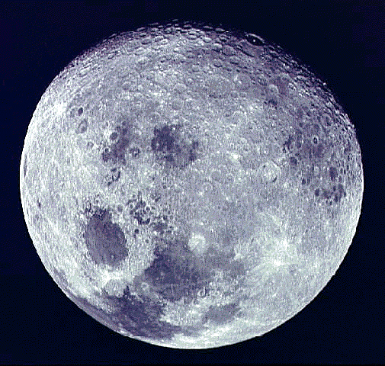
How was the Moon Formed?

Slide 37
How was the Moon formed?
Make detailed notes

Slide 38
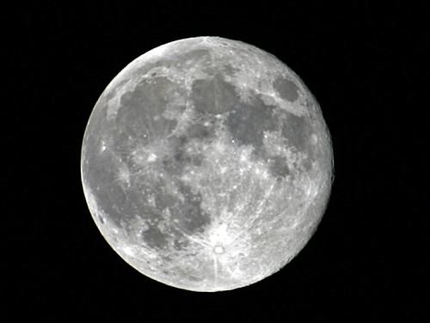
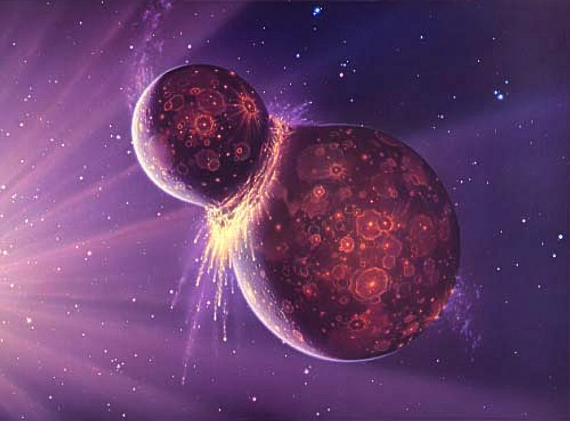
The Moon
It is thought that the Moon, Earth’s natural satellite, was formed after the Earth was hit by another large planet-sized object in the early days of the Solar System.
The Moon was formed from the lighter, less dense rocks thrown away from the Earth during the collision – the Earth’s dense iron core remained.
The Earth and Moon are about 4.6 billion years old – younger than the Universe at 13.6 billion years old
There is no Iron on the Moon.
The density of the Earth is 5500kg/m³ compared to the Moon’s density of 3300kg/m³. Oxygen content of rocks on Moon and Earth are similar.

